Slide 1

Unit 10: RECYCLING
EXERCISE

Slide 2
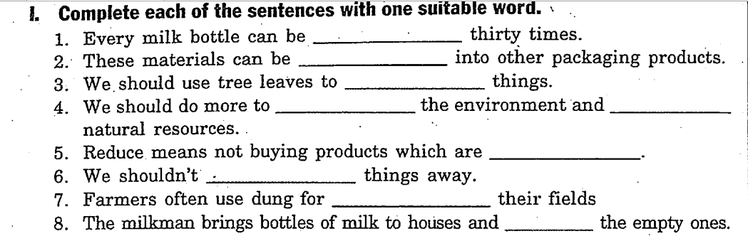
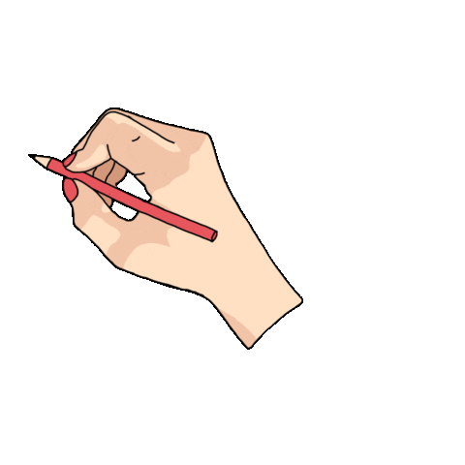
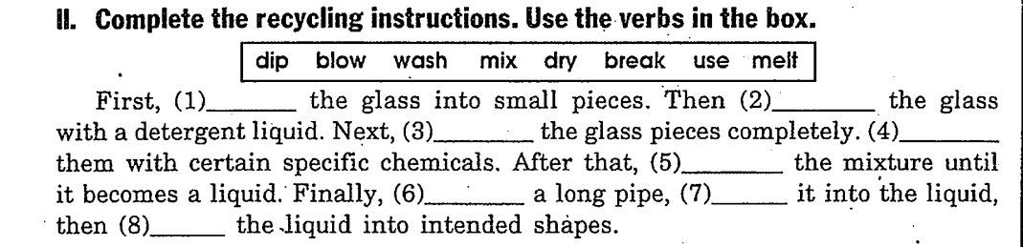
reused
recycled
wrap
protect
save
overpackaged
throw
fertilizing
collects
break
wash
dry
mix
melt
use
dip
blow

Slide 3
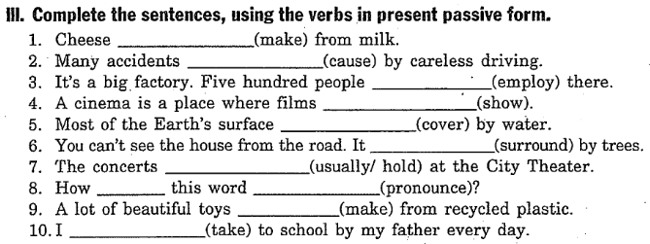
is made
are caused
are employed
are showed/ shown
is covered
is surrounded
are usually held
is
pronounced
are made
am taken

Slide 4
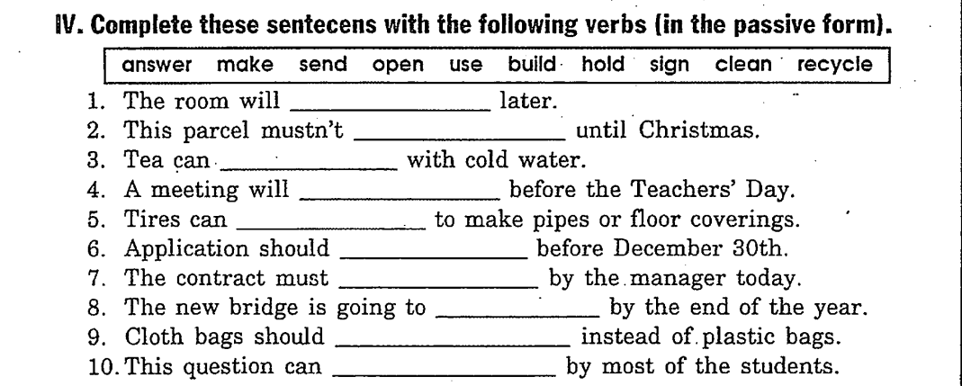
be cleaned
be opened
be made
be held
be recycled
be sent
be signed
be built
be used
be answered

Slide 5
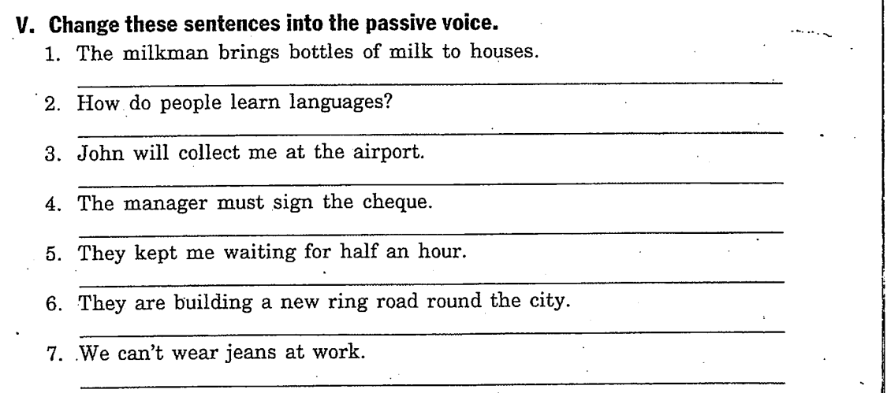
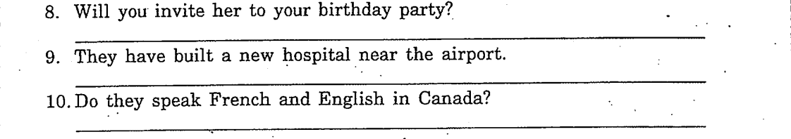
→ Bottles of milk are brought to house by the milkman.
→ How are languages learnt/ learned?
→ I will be collected at the airport by John.
→ The cheque must be signed by the manager.
→ I was kept waiting for half an hour.
→ A new ring road is being built round the city.
→ Jeans can’t be worn at work.
→ Will she be invited to your birthday party?
→ A new hospital has been built near the airport.
→ Are French and English spoken in Canada?

Slide 6
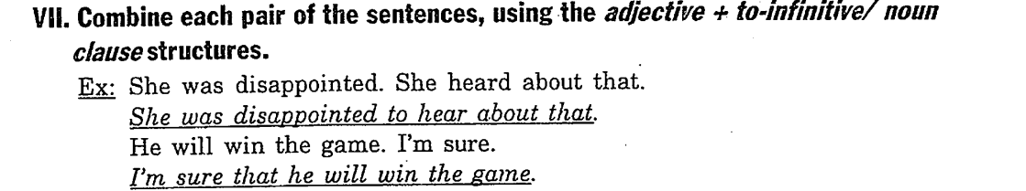
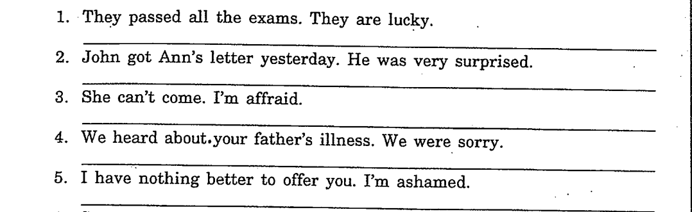
→ They are lucky to pass all the exams.
→ John was very surprised to get Ann’s letter yesterday.
→ I’m afraid that she can’t come.
→ We were sorry to hear about your father’s illness.
→ I’m ashamed to have nothing better to offer you.

Slide 7
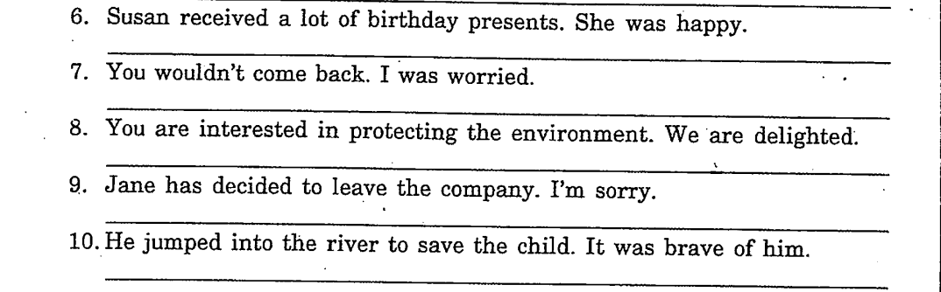
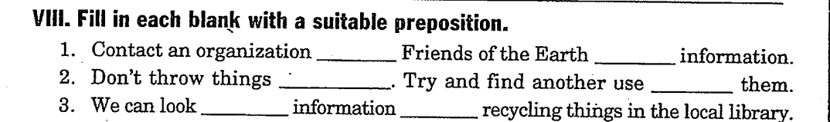
→ Susan was happy to receive a lot of birthday presents.
→ I was worried that you wouldn’t come back.
→ We are delighted that you are interested in protecting the environment.
→ I’m sorry that Jane has decided to leave the company.
→ It was brave for him to jump into the river to save the child.
→ He was brave to jump into the river to save the child.
like
for
away
for
for
on

Slide 8
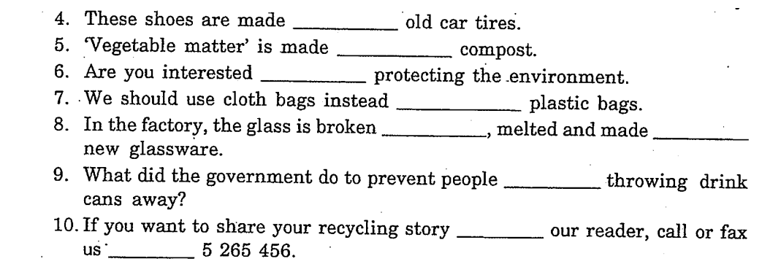
from
into
in
of
up
into
from
with
at

Slide 9
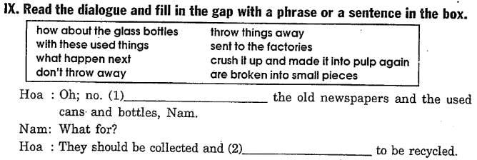
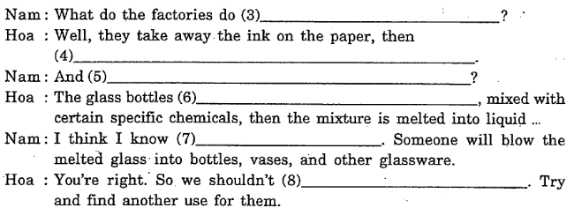
Don’t throw away
sent to the factory
with these used things
crush it up and made it into pulp again
how about the glass bottles
are broken into small pieces
what happen next
thrown things away

