Slide 1
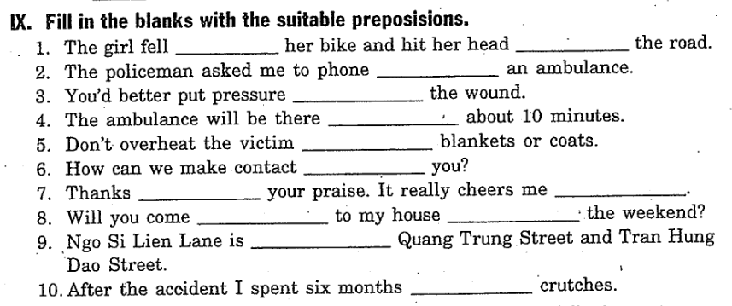
Unit 9 (cont) + Test for Unit 9
off
on
for
on
in
with
with
for
up
over
on
between
on

Slide 2
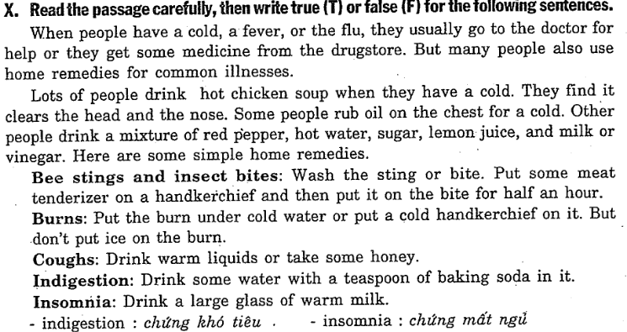
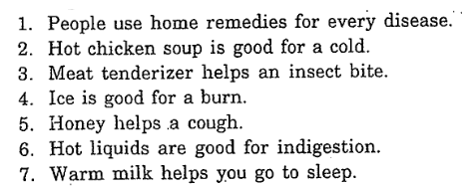
FALSE
TRUE
TRUE
FALSE
TRUE
FALSE
TRUE

Slide 3
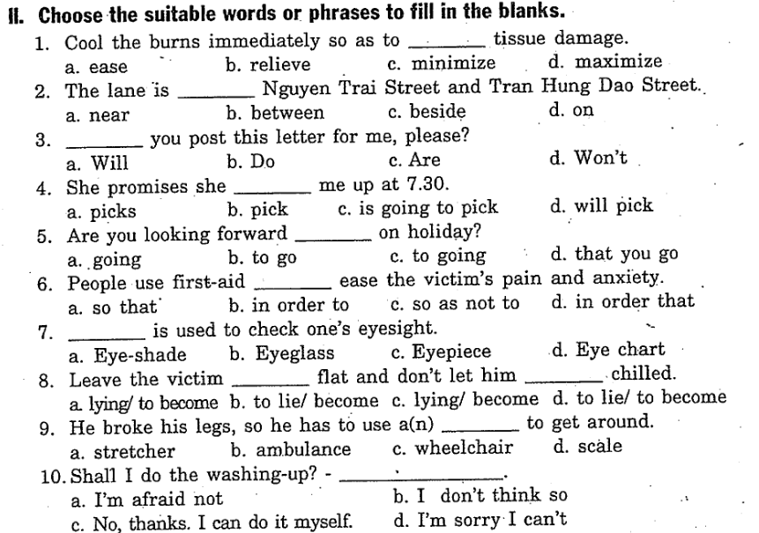
TEST FOR UNIT 9

Slide 4
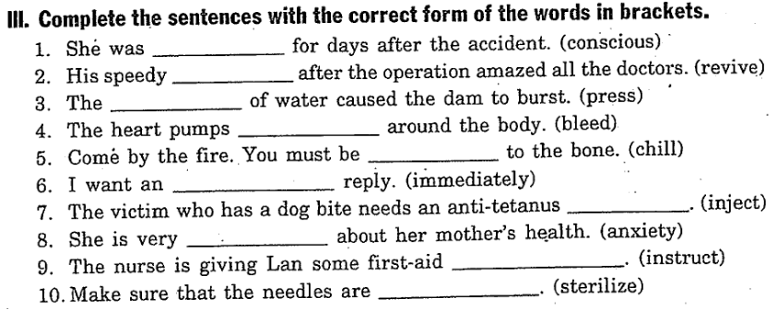
unconscious
revival
pressure
blood
chilled
immediate
injection
anxious
instructions
sterilized

Slide 5
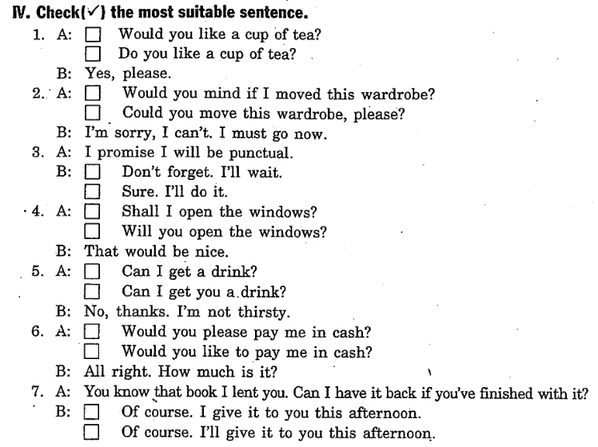
✓
✓
✓
✓
✓
✓
✓

Slide 6
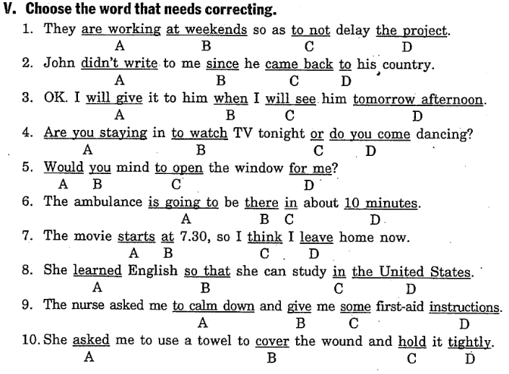
not to
hasn’t written
see
are you coming
opening
will
will leave
learns
gave
tight

Slide 7
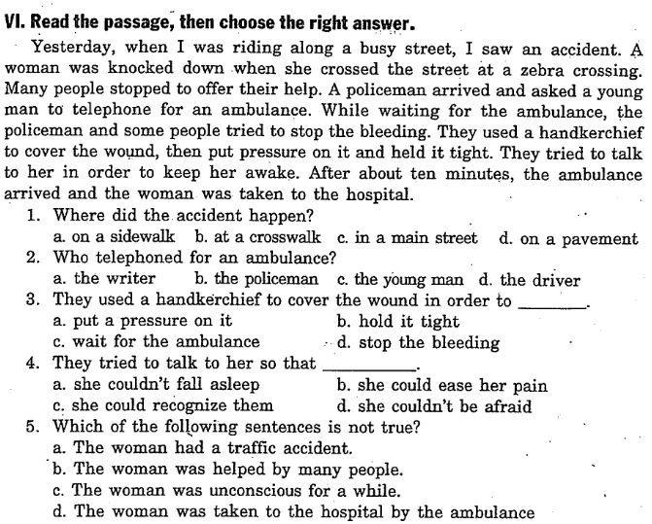

Slide 8
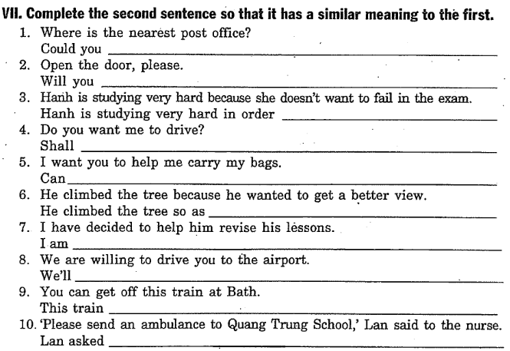
show me the way to the nearest post office?
open the door, please?
not to fail in the exam.
I drive?
you help me carry my bags?
to get a better view.
going to help him revise his lessons.
drive you to the airport.
stops at Bath.
the nurse to send to Quang Trung school.

