Slide 1

TRAN QUOC TOAN Secondary School
Welcome to our class
Teacher: HUỲNH LÊ THANH HẢI

Slide 2


KIM' S GAME

Slide 3
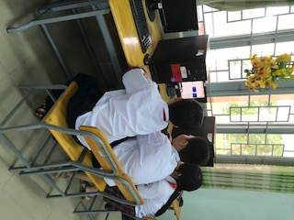
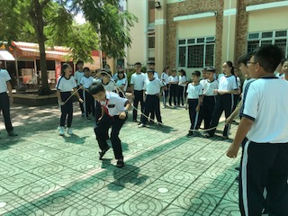

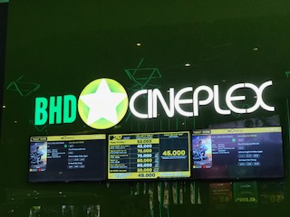
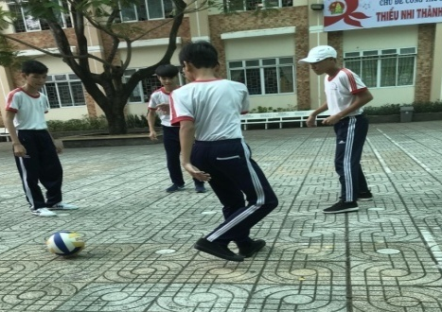
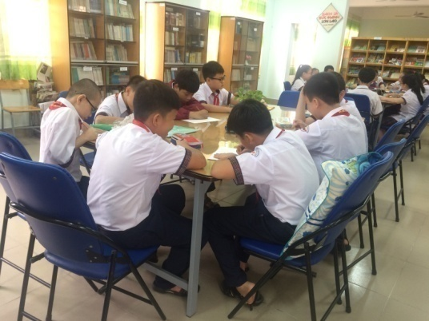
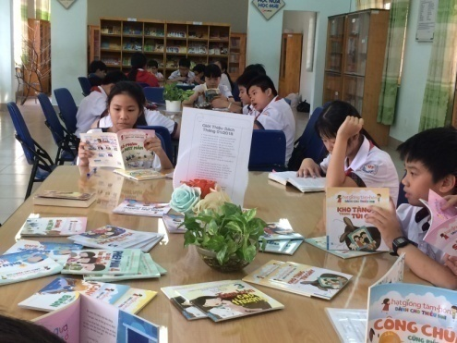
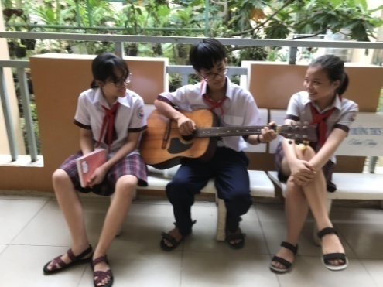
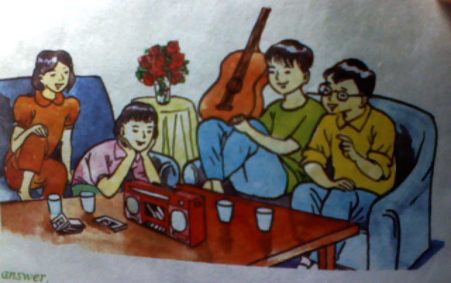
7
6
5
4
2
9
8
3
10
Over time
Time :
1
1
2
3
4
5
7
6
7
8

Slide 4





* LET’S PLAY
Kim’s game
60
55
0
5
50
10
45
15
40
20
35
25
30
OVER TIME
Notes:
4

Slide 5
7
6
5
4
9
8
3
10
1
2
Skip rope
Play computer games
4
3
4
5
Go to the movies
Play soccer
Do homework
7
8
6
7
8
Read books
Play the guitar
Listen to music

Slide 6

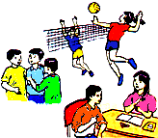

Saturday, November 3rd, 2018
Unit 6: After school
Part B1: Let’s go

Slide 7

Hoa
Nam
They are
Lan
Ba
1. What are they going to do this evening?
go to the movies B. watch TV
C. go to Lan’s house D. do homework

Slide 8
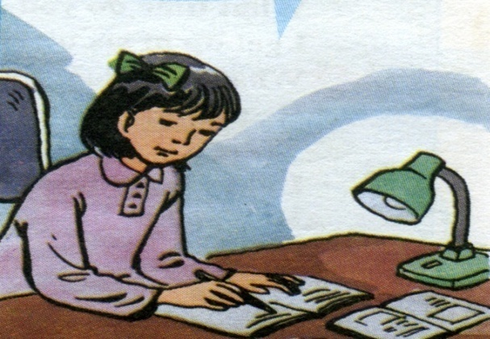
Saturday, November 3rd, 2018
UNIT 6: AFTER SCHOOL
PART B1: LET’S GO
1. Listen.Then practice in groups of four
❖ New words
- assignment (n)
→assign (v)

Slide 9

1.Listen. Then practice in groups of four
Ba: What should we do this evening?
Nam: What about going to the movies?
Lan: There aren’t any good movies on at the moment. Let’s go to my house. We can listen to some music.
Hoa: I’m sorry, Lan. I can’t come. I have too many
assignments.
Nam: Hoa! It is Sunday tomorrow.
Why don’t you relax ?
Ba: Come on. Let’s go to Lan’s house.
Lan: Are you going to come, Hoa? It’ll be fun.
Hoa: Ok. I’ll come. Thanks.
Nam: Great ! Now you’re learning to relax.
listen

Slide 10

B1. Listen .Then practice in groups of four.
Ba : What should we do this evening ?
Nam : What about going to the movies?
Lan : There aren’t any good movies on at the moment. Let’s go to my house. We can listen to some music.
Hoa : I’m sorry, Lan. I can’t come. I have too many assignments.
Nam : Hoa!. It is Sunday tomorrow. Why don’t you relax ?
Ba : Come on. Let’s go to Lan’s house.
Lan : Are you going to come, Hoa?
It’ll be fun.
Hoa : Ok. I’ll come. Thanks.
Nam : Great ! Now you’re learning to relax.
Suggestions:
1. What about going to the movies?
What about + V- ing +...?
2. Let’s go to my house.
Let’s + V-inf. + .....
3.Why don’t you relax ?
Why don’t you + V-inf…?

Slide 11
Make and respond to suggestions:
Suggestions | Agreement (+) | Disagreement(-)
What about +V-ing…? How about +V-ing…? Let’s + V(inf.)…. Why don’t we / you + V(inf.)….? Shall we + V(inf.)…? | + That’s a good idea. + Great. + Yes, let’s. + All right. + It’ll be fun. | I’m afraid, I can’t. I’m sorry, I can’t. No, let’s not.

Slide 12

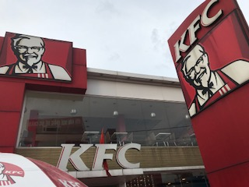
What about …………..................................................................?
That’s ………….............................................
going to KFC
a good idea.

Slide 13
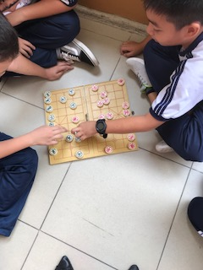
playing chess
What about ………………........................................?
I’m sorry, ………………….....
I can’t.

Slide 14
skip rope.
Let’s ………………….........................................…..
Yes, ………….................
let’s.

Slide 15
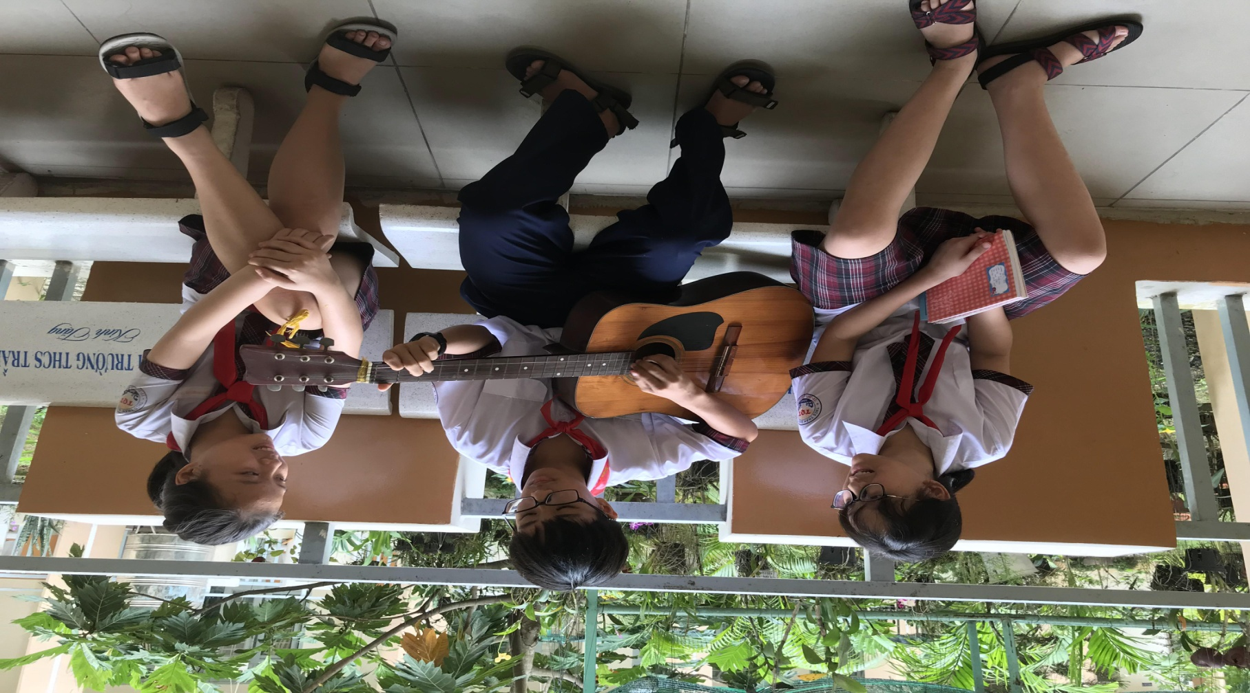
Why don’t we…………………..............................................................?
OK. It’ll…...............................
play the guitar
be fun.

Slide 16


Check True/False Statements
Statements | True | False
a. Nam wants to go to the movies. b. There good movies on at the moment. c. Lan wants to listen to some music at her house. d. Hoa too many assignments. e. Today is
T
are some
aren’t any
F
T
has
doesn’t have
F
Sunday.
Saturday.
F

Slide 17

MAGICAL HAT
1000
Gift
100
300
1
4
600
200
2
5
800
+ 2- Extra turn
3
No mark
400
6
100
700
500

Slide 18

a) What does Nam want to do ?
⇨Nam wants to go to the movies.

Slide 19

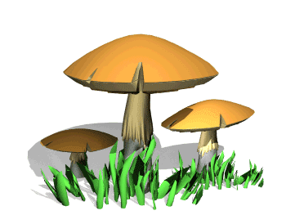
b) Why doesn’t Lan want to go to the movies?
Because there aren't any good movies on at the moment.

Slide 20

c) What does Lan want to do?
⇨Lan wants to listen to some music at her house.

Slide 21



Lucky gift
Lucky gift

Slide 22

d) Why doesn’t Hoa want to go to Lan’s house ?
Because she has too many assignments.

Slide 23
e) What day is it ?
⇨It's Saturday.

Slide 24
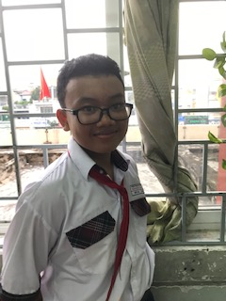
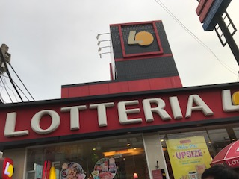
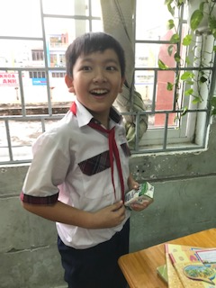
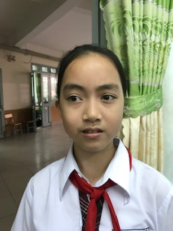

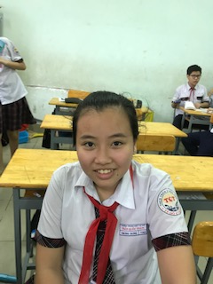
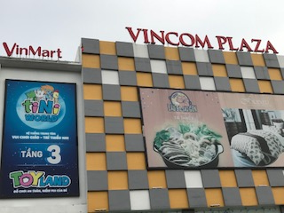
Complete the dialogue, using suggestions.
Why don’t……..………?
√
What are you going to do on the weekend?
Minh
What about…….…?
X
Phong
Thuy
X
How about……….?
√
Dung

Slide 25
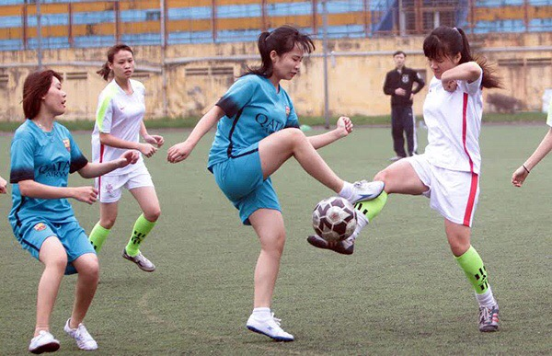
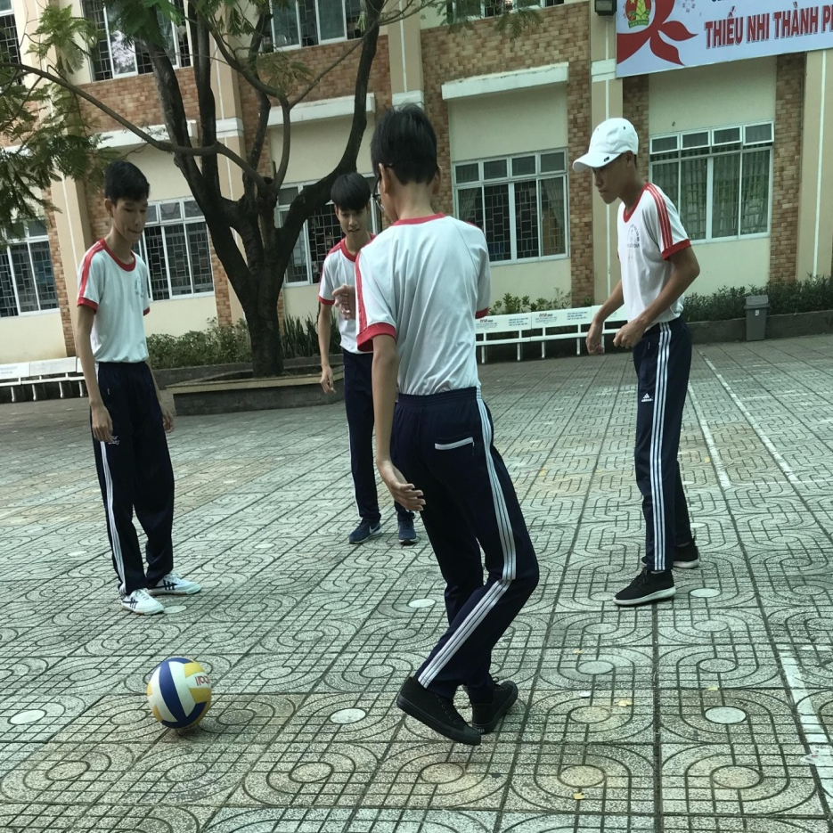
Saturday, November 3rd, 2018.
UNIT 6: AFTER SCHOOL- Part B1: LET’S GO

Slide 26
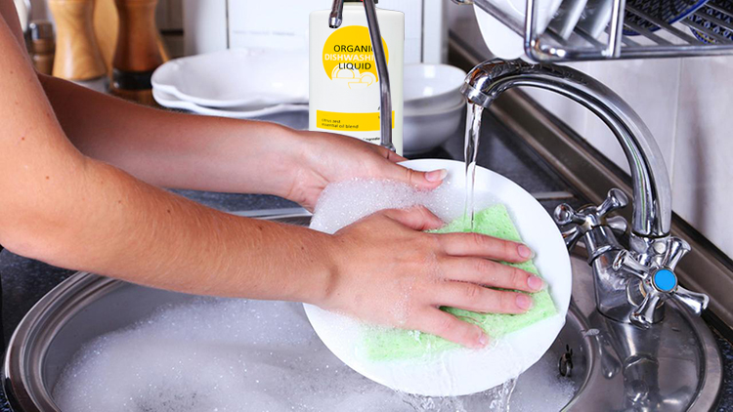
Saturday, November 3rd, 2018.
UNIT 6: AFTER SCHOOL- Part B1: LET’S GO

Slide 27
Saturday, November 3rd, 2018.
UNIT 6: AFTER SCHOOL- Part B1: LET’S GO

Slide 28

HOMEWORK
- Learn by heart the new words.
- Prepare Unit 6: Part B 2 - page 61

Slide 29

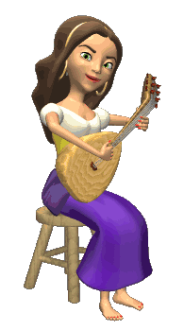

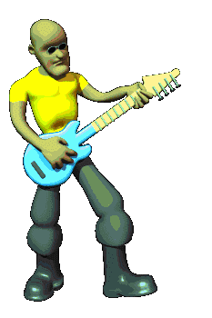






THANK YOU FOR ATTENTION!
GOOD BYE!
the end

