Slide 1

welcome to our class

Slide 2


Game: Try to remember
Mary
Tom
Who is Mary?
→
The woman wearing a green dress is Mary.
Who is Tom?
→
Tom is the man wearing a red shirt.

Slide 3

Unit 11: traveling around Vietnam
Language focus

Slide 4
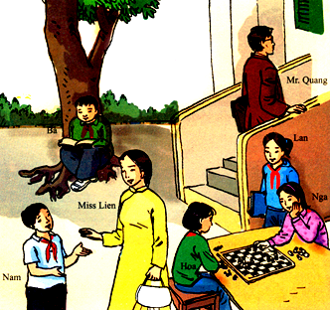
Mr.Quang
Lan
Ba
Miss Lien
Nga
Hoa
Nam

Slide 5
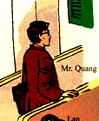
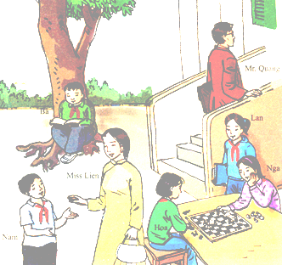

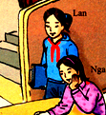


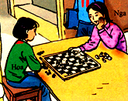
1/ What’s Mr. Quang doing?
3/ What’s Nam doing?
- He’s talking to Miss Lien.
4/ What’s Ba doing?
- He’s sitting under the tree.
5/ What’s Lan doing?
- She’s standing by the table.
5/ What are Nga and Hoa doing?
- They’re playing chess.
2/ What’s Miss Lien doing?
- She’s carrying a white bag.
- He’s walking up the stairs.

Slide 6
PRESENT PARTICIPLE
The man is walking up the stairs .He is Mr Quang
The man walking up the stairs is Mr. Quang.
(Present participle phrase)
Form:
V_ing  present participle
Usage:
a present participle (phrase) can be used as an adjective to qualify a noun with active meaning.

Slide 7
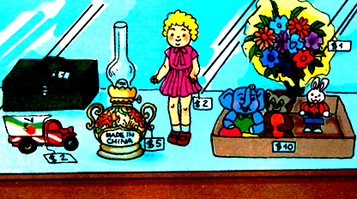
flowers
box
toys
doll
truck
Old lamp

Slide 8
QUESTIONS
Where is the old lamps made in?
What color is the box painted?
What is the toy truck recycled from?
What color is the doll dressed in?
5. What are the flowers wrapped in?
6. Where are the toys kept in?
(China)
(green)
(cans)
(pink)
(yellow)
(a cardboard box)

Slide 9
PAST PARTICIPLE
The old lamp is made in China. It is 5 dollars
The old lamp made in China is 5 dollars.
(Past participle phrase)
Form:
V_ed / V₃  past participle
Usage:
a past participle (phrase) can be used as an adjective to qualify a noun with passive meaning.

Slide 10

HOMEWORK
Learn by heart all structures UNIT 11

