Slide 1

Unit 2: CLOTHING
Lesson 1: Getting started. Listen and read.

Slide 2
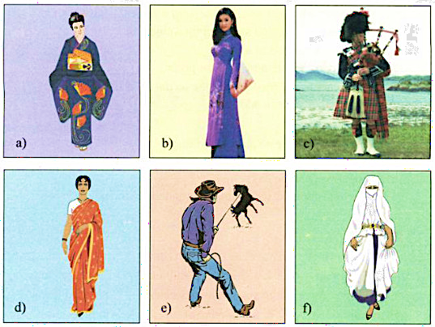
Look at the dress these people are wearing. Decide where each person comes from.
Japan-
a kimono
Scotland- a kilt
Vietnam- an ao dai
The USA-
cowboy boots and a cowboy hat
India-
a sari
Arabia-
a veil

Slide 3

Unit 2: CLOTHING
Lesson 1: Getting started. Listen and read.
For centuries, poets, writers and musicians have mentioned the ao dai in poems, novels and songs. The ao dai is the traditional dress of Vietnamese women. It consists of a long silk tunic that is slit on the sides and worn over loose pants. Traditionally, it was frequently worn by both men and women. The design and material used for men were different form those used for women. Nowadays, women usually wear it, especially on special occasions. However, many Vietnamese women today often prefer to wear modern clothing at work, because it is more convenient.
Now fashion designers want to change the traditional ao dai. Some have printed lines of poetry on the ao dai, so they look modern and very fashionable. Other designers have taken inspiration from Vietnam’s ethnic minorities. They have visited villages and studied traditional designs and symbols such as suns, stars, crosses, and stripes. They have added theses patterns to the ao dai, so Vietnamese women can continue to wear the unique dress, which is now both traditional and fashionable.

Slide 4
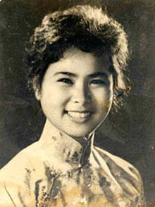
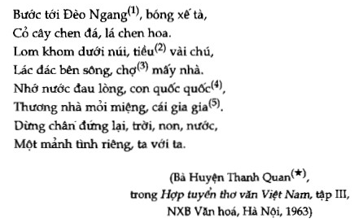

poem (n) /ˈpoʊ.əm/
poetry (n) /ˈpoʊ.ə.tri/
poetic (a) /poʊˈet̬.ɪk/
poet (n) /ˈpoʊ.ət/
poetically (adv) /poʊˈet̬.ɪ.kəl.i/
lines of poetry (n)

Slide 5
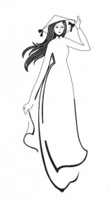
Poems: Ao trang, Ao dai trong toi, …
Songs: Mot thoang que huong, Xinh tuoi Viet Nam, …
wear- wore- worn (v)
/wer/ /wɔːr/ /wɔːrn/
= put on
mention (v) /ˈmen.ʃən/
e.g. For centuries, poets, writers and musicians have mentioned the ao dai in poems, novels and songs.

Slide 6
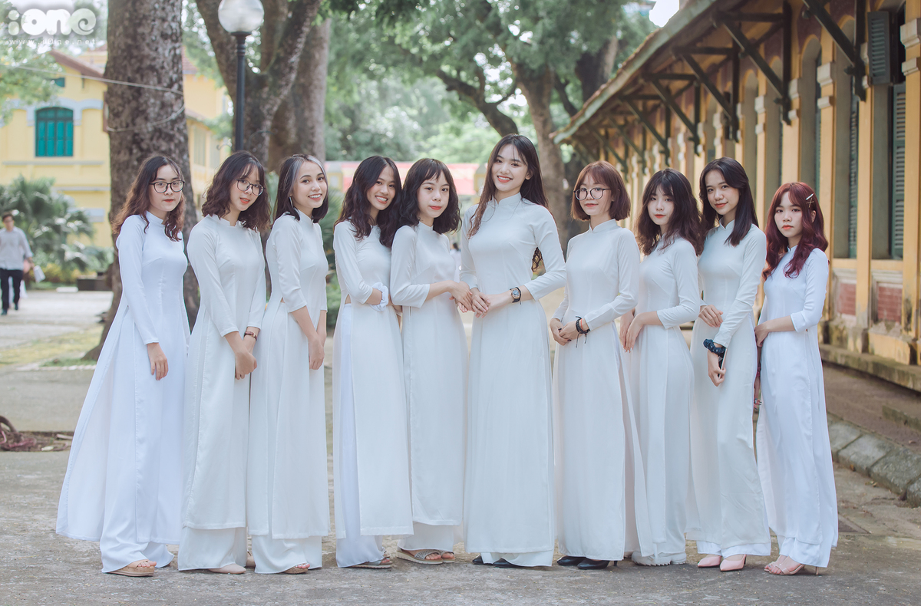
tunic (n) /ˈtjuː.nɪk/
slit (n) /slɪt/
slit- slit- slit (v)
e.g. The ao dai consists of a long silk tunic that is slit on the sides.

Slide 7
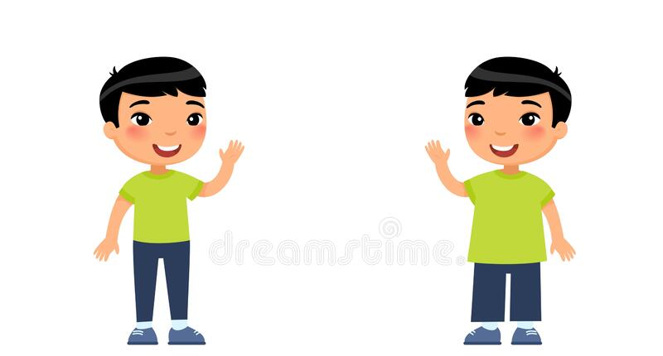
tight (a) /taɪt/
loose (a) /luːs/
loosen (v) /ˈluː.sən/

Slide 8
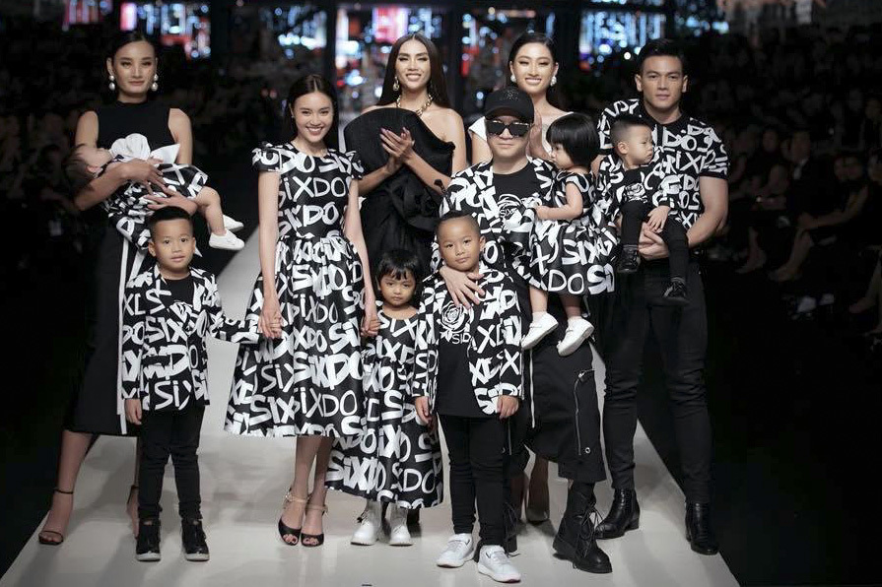
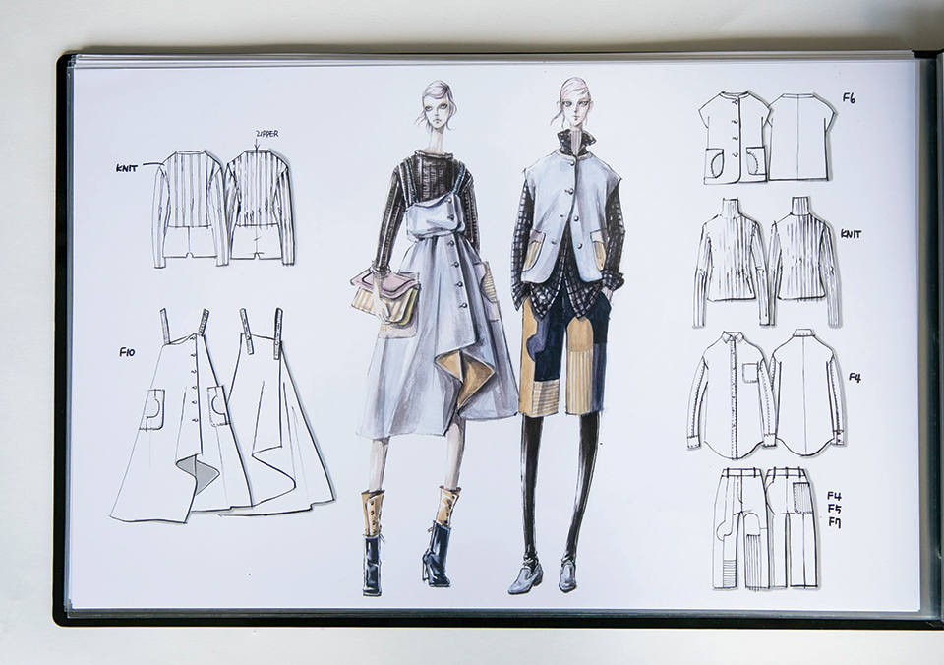
design (v) /dɪˈzaɪn/
fashion designer (n) /ˈfæʃ.ən dɪˈzaɪ.nɚ/

Slide 9
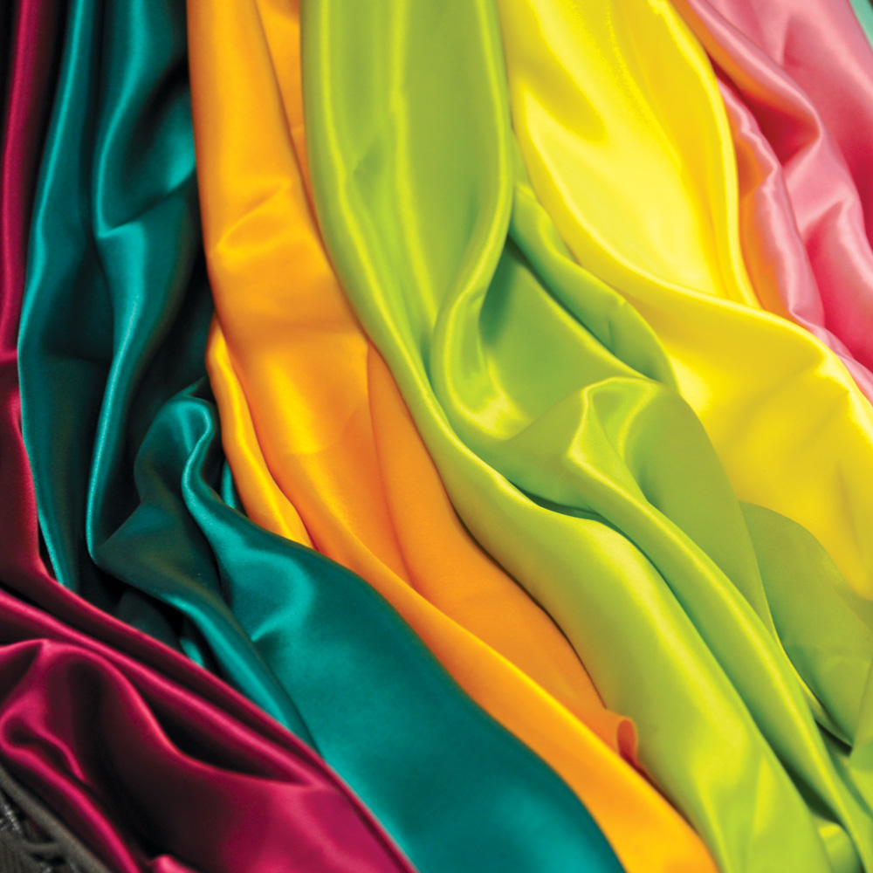
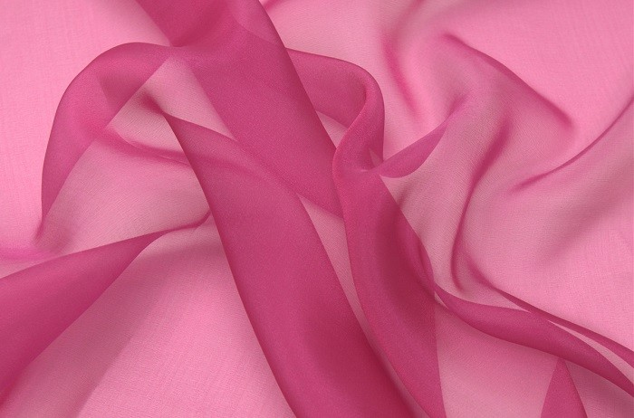
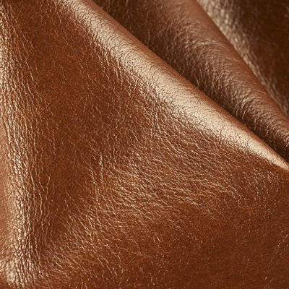
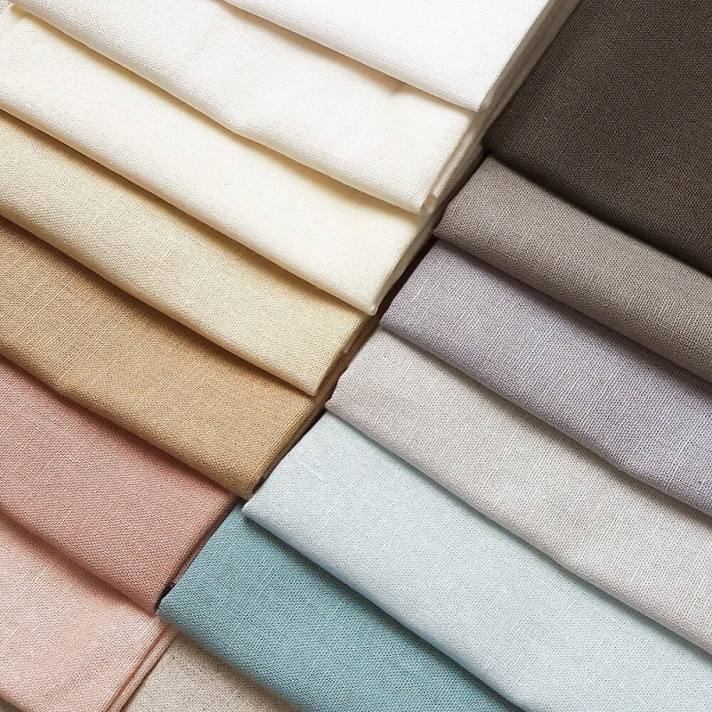
material (n) /məˈtɪr.i.əl/

Slide 10
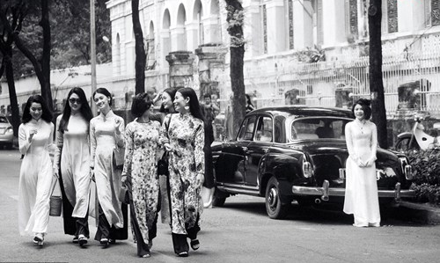
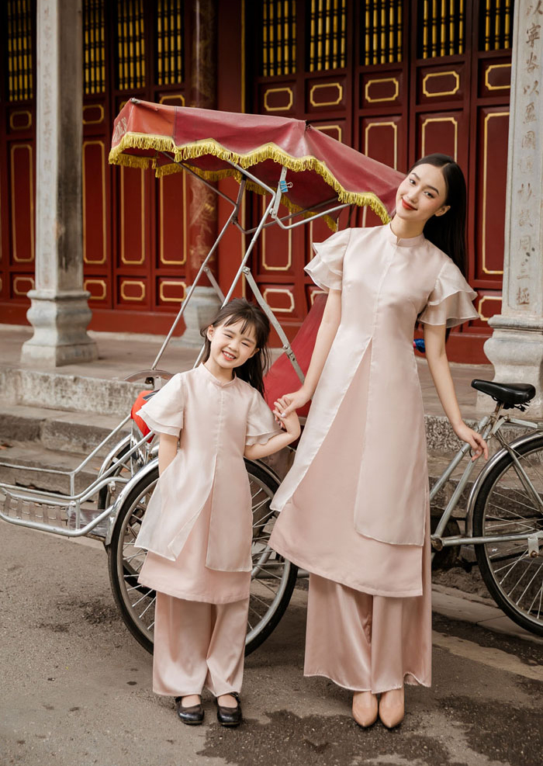
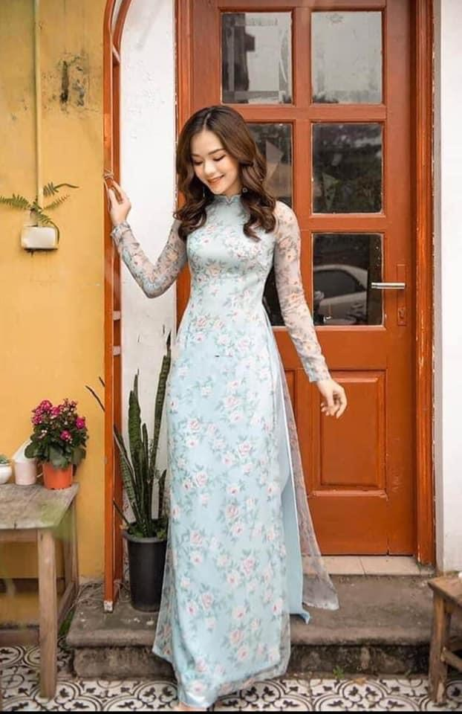
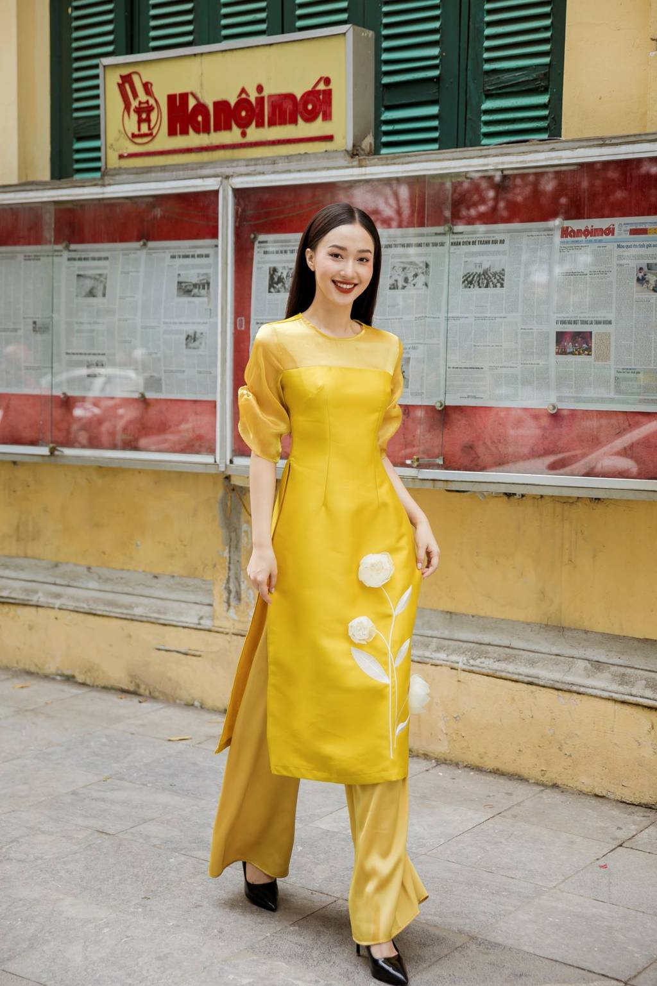
modern (a) /ˈmɑː.dɚn/
modernity (n) /mɑːˈdɝː.nə.t̬i/
modernize/se (v) /ˈmɑː.dɚ.naɪz/
modernization (n) /ˌmɑː.dɚ.nəˈzeɪ.ʃən/

Slide 11
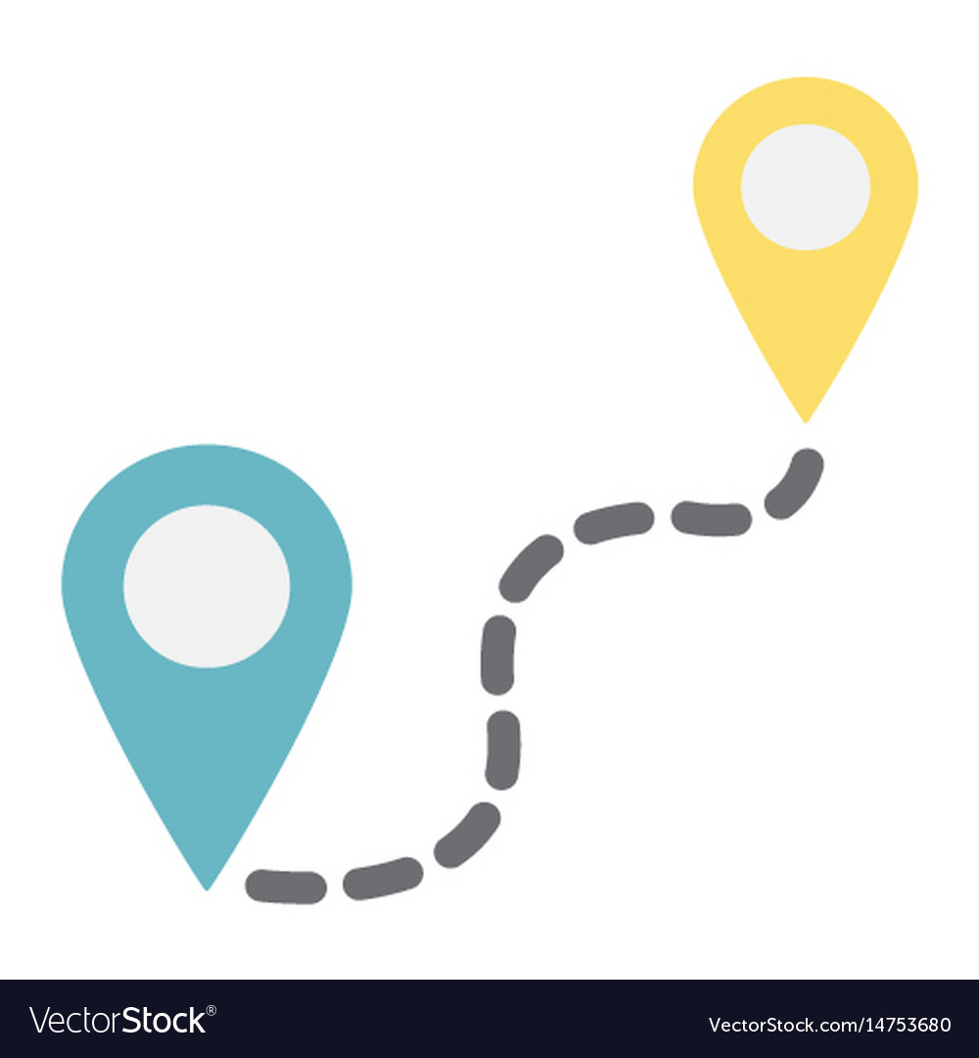
e.g. Living near the school/office is convenient because you don’t have too much time to go or get a traffic jam.
convenient (a) /kənˈviː.ni.ənt/
inconvenient (a) /ˌɪnkənˈviː.ni.ənt/
convenience (n) /kənˈviː.ni.əns/
inconvenience (n) /ˌɪnkənˈviː.ni.əns/
conveniently (adv) /kənˈviːn.jənt.li/
inconveniently (adv) /ˌɪnkənˈviːn.jənt.li/

Slide 12
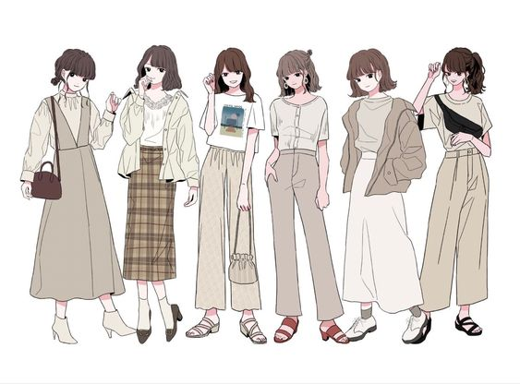
fashion (n) /ˈfæʃ.ən/
fashionable (a) / ˈfæʃ.ən.ə.bəl/
fashionably (adv) /ˈfæʃ.ən.ə.bli/
old- fashioned (a) /ˌoʊldˈfæʃ.ənd/
out of fashion (exp.)

Slide 13
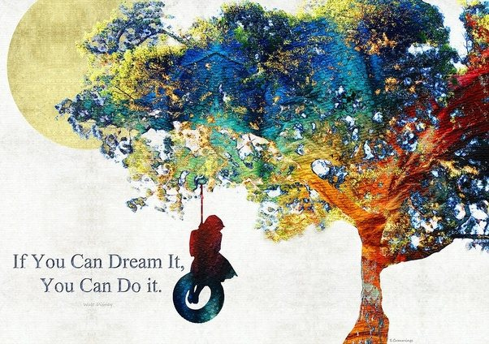
inspiration (n) /ˌɪn.spəˈreɪ.ʃən/
inspirational (n) /ˌɪn.spəˈreɪ.ʃən.əl/
inspire (v) /ɪnˈspaɪər/
take inspiration from

Slide 14
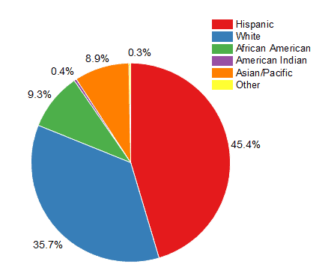
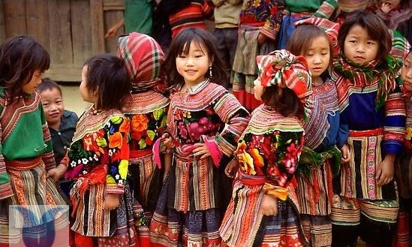
minority (n) /maɪˈnɔːr.ə.t̬i/
majority (n) /məˈdʒɑː.rə.t̬i/
minor (a) /ˈmaɪ.nɚ/
major (a) /ˈmeɪ.dʒɚ/
ethnic minority (n) /ˌeθ.nɪk maɪˈnɑːr.ə.t̬i/

Slide 15

symbol (n) /ˈsɪm.bəl/
symbolize (v) /ˈsɪm.bə.laɪz/

Slide 16


cross (n) /krɑːs/

Slide 17
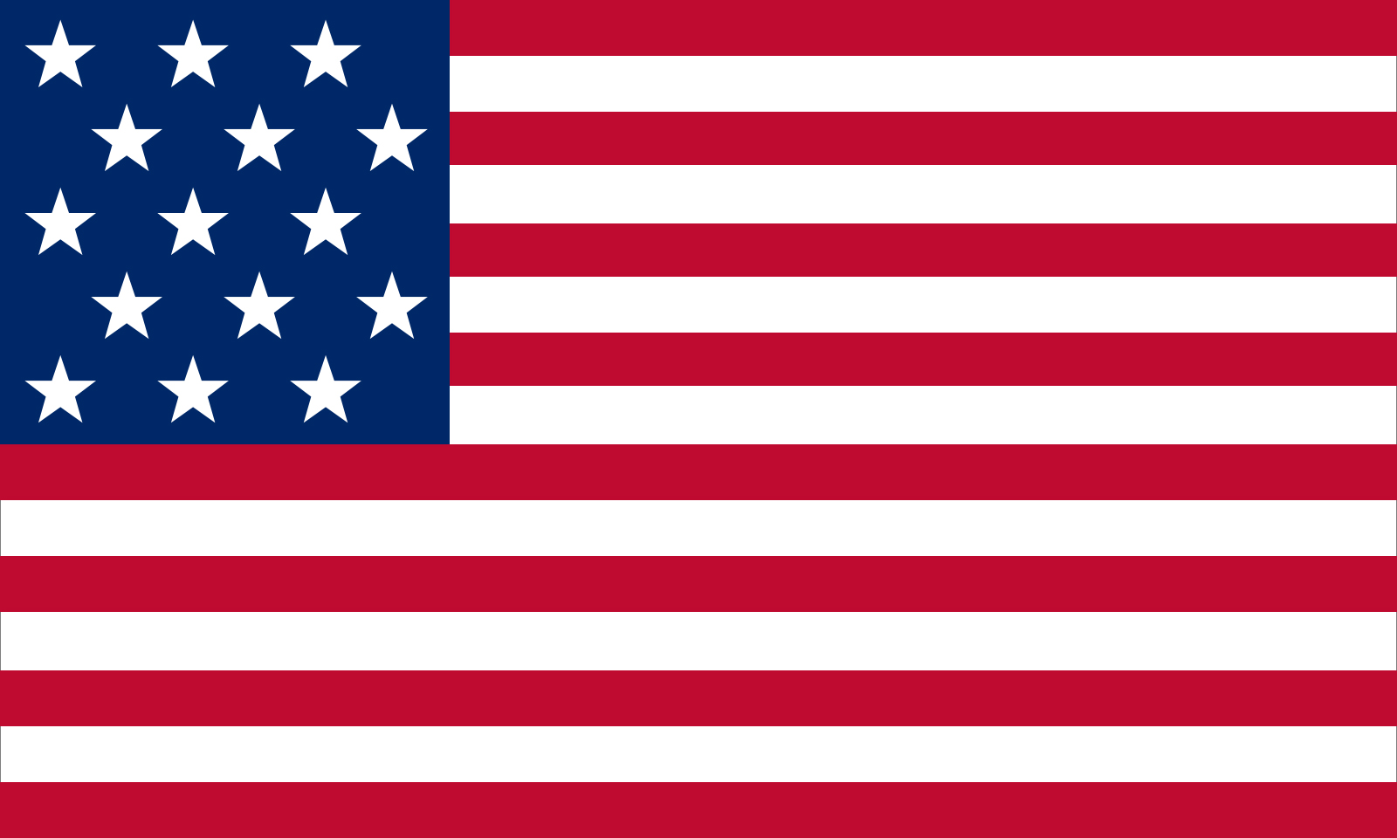
stripe (n) /straɪp/
striped (a) /straɪpt/

Slide 18
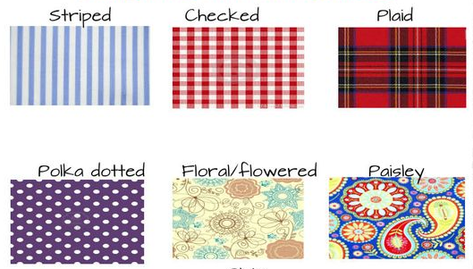
pattern (n) /ˈpæt̬.ɚn/

Slide 19
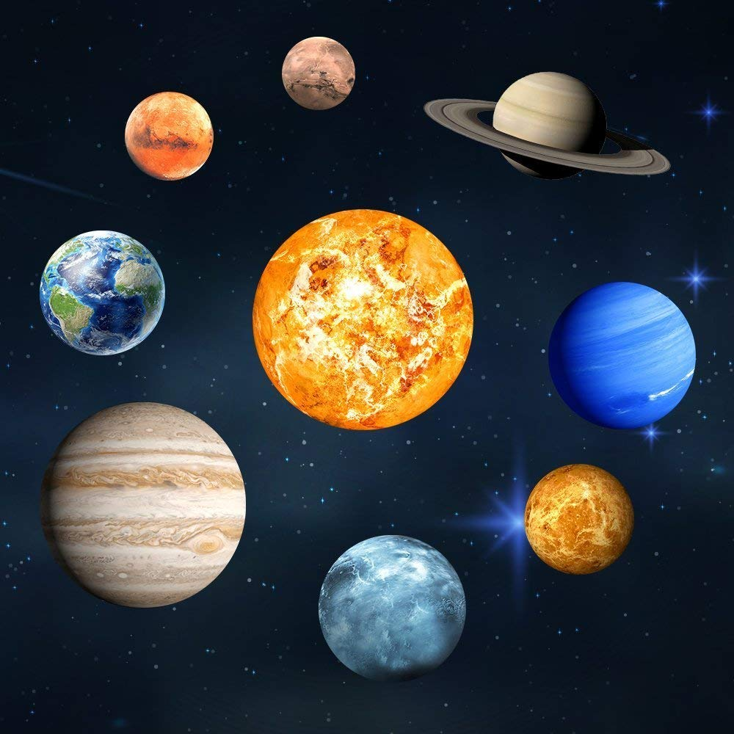
unique (a) /juːˈniːk/
uniquely (adv) /juːˈniːk.li/
uniqueness (n) /juːˈniːk.nəs/

Slide 20

alternative (n,a)
/ɑːlˈtɝː.nə.t̬ɪv/

Slide 21
Unit 2: CLOTHING
Lesson 1: Getting started. Listen and read.
* Vocabulary.
1 | Poet/poem/poetry (n.) Poetic (a.) Poetically (adv.) lines of poetry (n.) | /ˈpoʊ.ət/, /ˈpoʊ.əm/, /ˈpoʊ.ə.tri/ /poʊˈet̬.ɪk/ /poʊˈet̬.ɪ.kəl.i/ | nhà thơ/bài thơ/thơ ca những câu thơ
2 | Mention (v.) | /ˈmen.ʃən/ | đề cập đến, nói đến
3 | Wear- wore- worn (v.) = put on | /wer/- /wɔːr/- /wɔːrn/ | Mặc, đội, mang
4 | Tunic (n.) | /ˈtjuː.nɪk/ | (quần áo) rộng và chùng
5 | Slit (n.) Slit/slit/slit (v.) | /slɪt/ | đường xẻ xẻ, chẻ, rọc ra

Slide 22
Unit 2: CLOTHING
Lesson 1: Getting started. Listen and read.
* Vocabulary.
6 | Loose (a.) # tight Loosen (v.) | /luːs/ # /taɪt/ /ˈluː.sən/ | rộng, lòng thòng
7 | Design (n.) Fashion designer (n.) | /dɪˈzaɪn/ /ˈfæʃ.ən dɪˈzaɪ.nɚ/ | kiểu dáng thiết kế/nhà thiết kế
8 | Material (n.) | /məˈtɪr.i.əl/ | chất liệu
9 | Modern (a.) Modernity (n.) Modernize/se (v.) Modernization (n.) | /ˈmɑː.dɚn/ /mɑːˈdɝː.nə.t̬i/ /ˈmɑː.dɚ.naɪz/ /ˌmɑː.dɚ.nəˈzeɪ.ʃən/ | hiện đại hiện đại hóa
10 | (in) convenient (a.) (in) convenience (n.) (in) conveniently (adv.) | /(ɪn) kənˈviː.ni.ənt/ /(ɪn) kənˈviːn.jəns/ /(ɪn) kənˈviːn.jənt.li/ | (bất) tiện lợi

Slide 23
Unit 2: CLOTHING
Lesson 1: Getting started. Listen and read.
* Vocabulary.
11 | Fashion (n.) Fashionable (a.) Fashionably (adv.) Old- fashioned (a.) Out of fashion (exp.) | /ˈfæʃ.ən/ /ˈfæʃ.ən.ə.bəl/ /ˈfæʃ.ən.ə.bli/ /ˌoʊldˈfæʃ.ənd/ | thời trang hợp thời trang lạc hậu, không hợp thời lỗi thời
12 | Inspiration (n.) Inspirational (a.) Inspire (v.) Take inspiration from | /ˌɪn.spəˈreɪ.ʃən/ /ˌɪn.spəˈreɪ.ʃən.əl/ /ɪnˈspaɪər/ | cảm hứng truyền cảm hứng lấy cảm hứng từ
13 | Minority (n.) (ies. pl.) Minor (a.) Ethnic minority (n.) | /maɪˈnɔːr.ə.t̬i/ /ˈmaɪ.nɚ/ /ˌeθ.nɪk maɪˈnɑːr.ə.t̬i/ | thiểu số thứ yếu dân tộc thiểu số
14 | Symbol (n.) Symbolize (v.) | /ˈsɪm.bəl/ /ˈsɪm.bə.laɪz/ | biểu tượng

Slide 24
Unit 2: CLOTHING
Lesson 1: Getting started. Listen and read.
* Vocabulary.
15 | Cross (n.) | /krɑːs/ | dấu chéo, chữ thập
16 | Stripe (n.) Striped (a.) | /straɪp/ /straɪpt/ | sọc, vạch kẻ có sọc
17 | Pattern (n.) | /ˈpæt̬.ɚn/ | mẫu kiểu
18 | Unique (a.) Uniquely (adv.) Uniqueness (n.) | /juːˈniːk/ /juːˈniːk.li/ /juːˈniːk.nəs/ | độc đáo, có một không hai
19 | Majority (n.) Major (a.) | /məˈdʒɑː.rə.t̬i/ /ˈmeɪ.dʒɚ/ | đa số lớn, nhiều, chủ yếu
20 | Alternative (n.) Alternative (a.) | /ɑːlˈtɝː.nə.t̬ɪv/ | sự lựa chọn. có thể chọn để thay thế cho vật khác, khác

Slide 25
Practice 1: Match the word in column A to the explanation in column B.
 | A | B
1 | symbol | a) the larger number or part of something
2 | designer | b) a sign, shape, or object that is used to represent something
3 | slit | c) not modern
4 | convenient | d) a person who imagines how something could be made
5 | old- fashioned | e) not firmly fixed in place/ not tight
6 | loose | f) a smaller number or part
7 | majority | g) make a long, straight, narrow cut in something
8 | minority | h) comfortable, serviceable
b
g
c
a
1- 2- 3- 4- 5- 6- 7- 8-
Answers:
d
h
e
f

Slide 26
Unit 2: CLOTHING
Lesson 1: Getting started. Listen and read.
For centuries, poets, writers and musicians have mentioned the ao dai in poems, novels and songs. The ao dai is the traditional dress of Vietnamese women. It consists of a long silk tunic that is slit on the sides and worn over loose pants. Traditionally, it was frequently worn by both men and women. The design and material used for men were different form those used for women. Nowadays, women usually wear it, especially on special occasions. However, many Vietnamese women today often prefer to wear modern clothing at work, because it is more convenient.
Now fashion designers want to change the traditional ao dai. Some have printed lines of poetry on the ao dai, so they look modern and very fashionable. Other designers have taken inspiration from Vietnam’s ethnic minorities. They have visited villages and studied traditional designs and symbols such as suns, stars, crosses, and stripes. They have added theses patterns to the ao dai, so Vietnamese women can continue to wear the unique dress, which is now both traditional and fashionable.

Slide 27
Practice 2: Fill in each gap with a word from the box.
alternative unique inspiration symbolize tunic
ethnic striped mention poems
I really like traditional clothes. To me, the ao dai has a ____________ beauty that no other outfit has.
He looked so handsome in his fancy blue ____________.
He gave an inspirational reading of his own _____________.
What was your _____________ for the new designs?
Kim knew she had no ______________ but to obey.
The most popular _____________ food I the United States is Italian food.
Do you prefer plain or __________ shirts?
I’d rather you didn’t ____________ it when we’re in company.
unique
tunic
poems
inspiration
alternative
ethnic
striped
mention

Slide 28
Practice 3: Read the passage (pp.13-14) and decide whether the statements that follow are True or False.
1. The ao dai has been mentioned in poems, novels and songs for a long time.
2. The design and material used for men and women weren’t the same.
3. The majority of Vietnamese women prefer to wear ao dai at work.
4. Fashion designers don’t know how to modernize the ao dai.
5. Nowadays, not only women but also men wear the ao dai on special occasions.
True
True
False
False
False
Evidence 3 (line 7,8/ p.13): However, many Vietnamese women today often prefer to wear modern clothing at work, because it is more convenient.
Evidence 4 (p.14): Some have printed lines of poetry on, other designers have taken inspiration from Vietnam’s ethnic minorities.
Evidence 2 (line 4,5/ p.13): The design and material used for men were different form those used for women.
Evidence 1 (line 1,2/ p.13): For centuries, poets, writers and musicians have mentioned the ao dai in poems, novels and songs.
Evidence 5 (line 6/p.13): Nowadays, women usually wear it, especially on special occasions.

Slide 29
Practice 4: Complete the sentences. Use the information from the passage.
For a long time, the ao dai has been the subject of _______________________.
The ao dai is described as a _________________________________________ _____________.
The majority of Vietnamese women prefer _____________________________.
Some designers have modernized the ao dai by printing ___________________.
Another alternative is to add ________________________________________.
poems, novels and songs
long silk tunic with slits up the sides worn over
loose pants
to wear modern clothing at work
lines of poetry on it
symbols such as suns, stars, crosses and stripes

Slide 30
Practice 5: Answer the questions.
Who used to wear the ao dai by tradition?
2. Why do the majority of Vietnamese women prefer to wear modern clothing at work these days?
3. What have fashion designers done to modernize the ao dai?
→ Traditionally, both men and women used to wear the ao dai.
→ They prefer to wear modern clothing at work these days because it is more convenient.
→ They have printed lines of poetry on the ao dai, or have added symbols such as suns, stars, crosses and stripes to the ao dai.

Slide 31
Practice 6: Multiple choice.
Nowadays, Vietnamese women usually wear the ao dai _______ special occasions.
in B. on C. at D. for
2. The ao dai __________ a long silk tunic that is slit on the sides.
keeps in B. consists of C. makes from D. wears over
3. Now fashion __________ want to change the traditional ao dai.
writers B. musicians C. designers D. poets
4. Have they ___________ the ao dai recently?
inspired B. modernized C. slit D. marched
5. This room is very dirty. It _________ for ages.
A. didn’t used B. wasn’t used C. isn’t used D. hasn’t been used

Slide 32
Practice 6: Multiple choice.
6. For many people, the horseshoe is a _______ of good luck.
sign B. signal C. symptom D. symbol
7. The designers have taken inspiration __________ this ancient town.
at B. to C. from D. on
8. To Huu is considered as one of the most famous Vietnamese __________.
poets B. poems C. poetry D. poetic
9. How many ___________ are there on the America’s flag?
symbols B. slits C. stripes D. crosses
10. My sister finds her new pink ao dai very modern and _________.
A. fashionable B. inconvenient C. famous D. equal

Slide 33
Practice 7: Use the correct from of the word in each sentence.
___________, we visit our relatives and friends on New Year’s Day. (tradition)
My sister has the _____________ to create new designs for the ao dai. (inspire)
Red ____________ danger. (symbol)
Some designers have ____________ the ao dai by printing lines of the poetry on it. (modern)
It will be very _____________ for me to have no car. (convenience)
The language my teacher of English uses is very ___________. (poetry)
This is one of the famous fashion ____________ in our city. (design)
The ___________ of the employees have university degrees. (major)
Traditionally
inspiration
symbolizes
modernized
inconvenient
poetic
designers
majority

Slide 34
HOMEWORK
Learn the vocabulary by heart.
Prepare lesson 2: Speak
Write a short paragraph about your favorite clothing.

Slide 35


