Slide 1

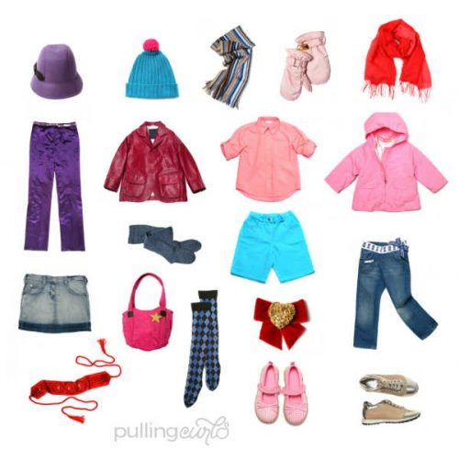
UNIT 2 : CLOTHING Lesson 2: Speak

Slide 2










CLOTHING

Slide 3
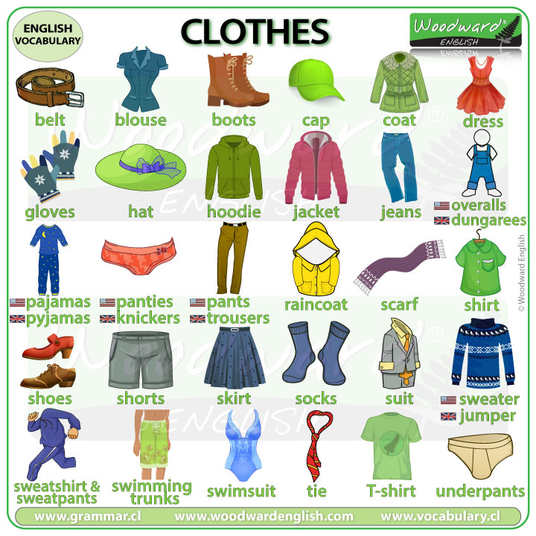

Slide 4
I: VOCABULARY:

Slide 5

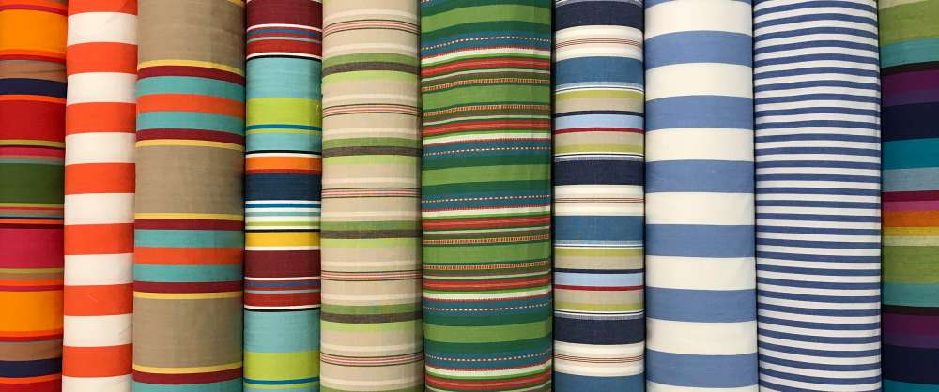
stripe (n)
sọc
/straɪp/
I chose the fabric with stripes.

Slide 6
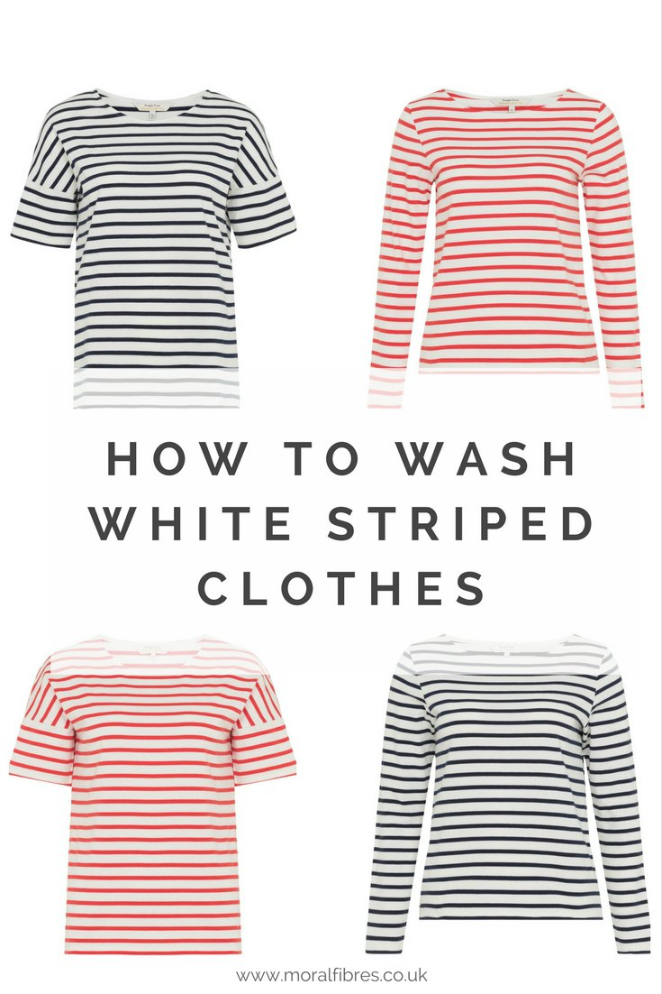
striped (adj)
có sọc
/straɪp/

Slide 7
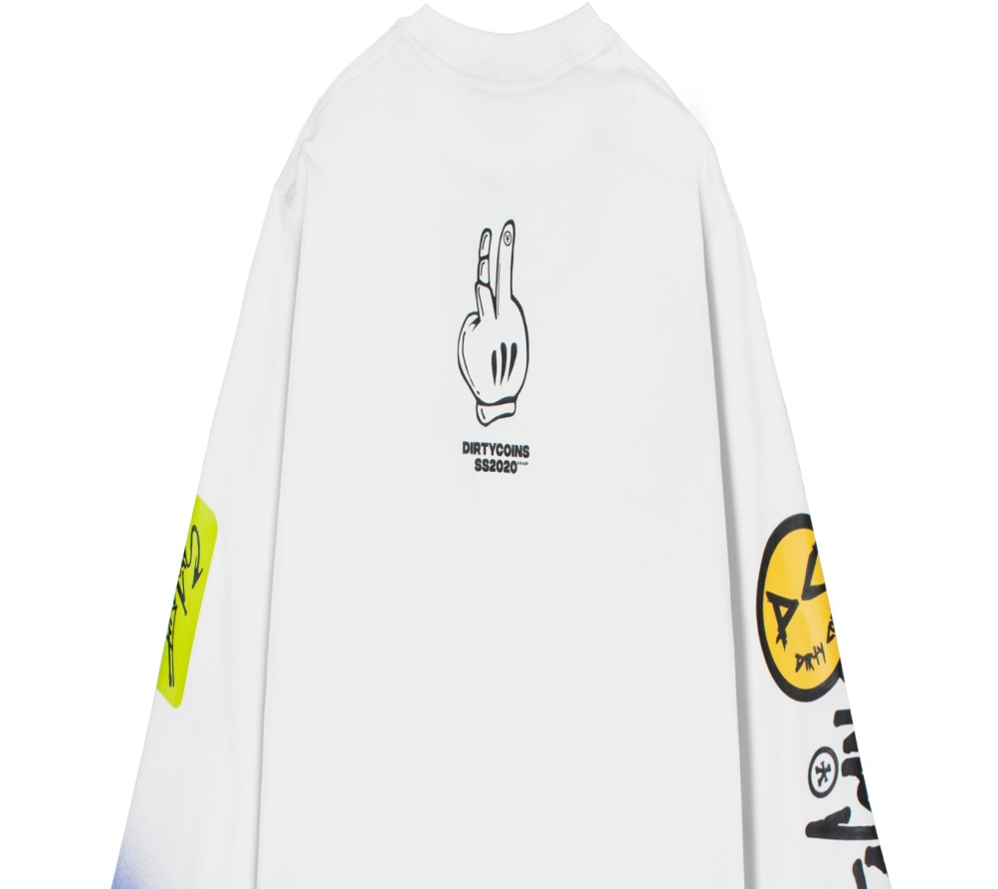
sleeve (n)
tay áo
/sliːv/
The sleeves are too long for me.

Slide 8
sleeved /sliːvd/ (adj) : có tay áo
sleeve (n): tay áo short-sleeved (adj): tay ngắn
sleeveless /ˈsliːvləs/ (adj): không có tay

Slide 9
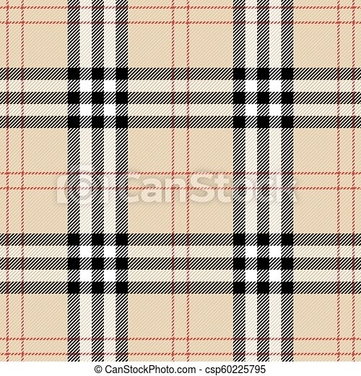
plaid (adj)
có ca-rô, kẻ ô vuông
/plæd/
A plaid is a pattern of squares and lines on cloth.

Slide 10
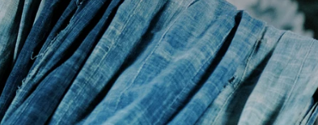
fade (v)
làm nhạt
/feɪd/
If you hang your clothes out in the bright sun, they will fade.

Slide 11
fade /feɪd/ (v) : làm nhạt
+ fade away : mất dần + faded /ˈfeɪ.dɪd/ (adj) : phai màu

Slide 12
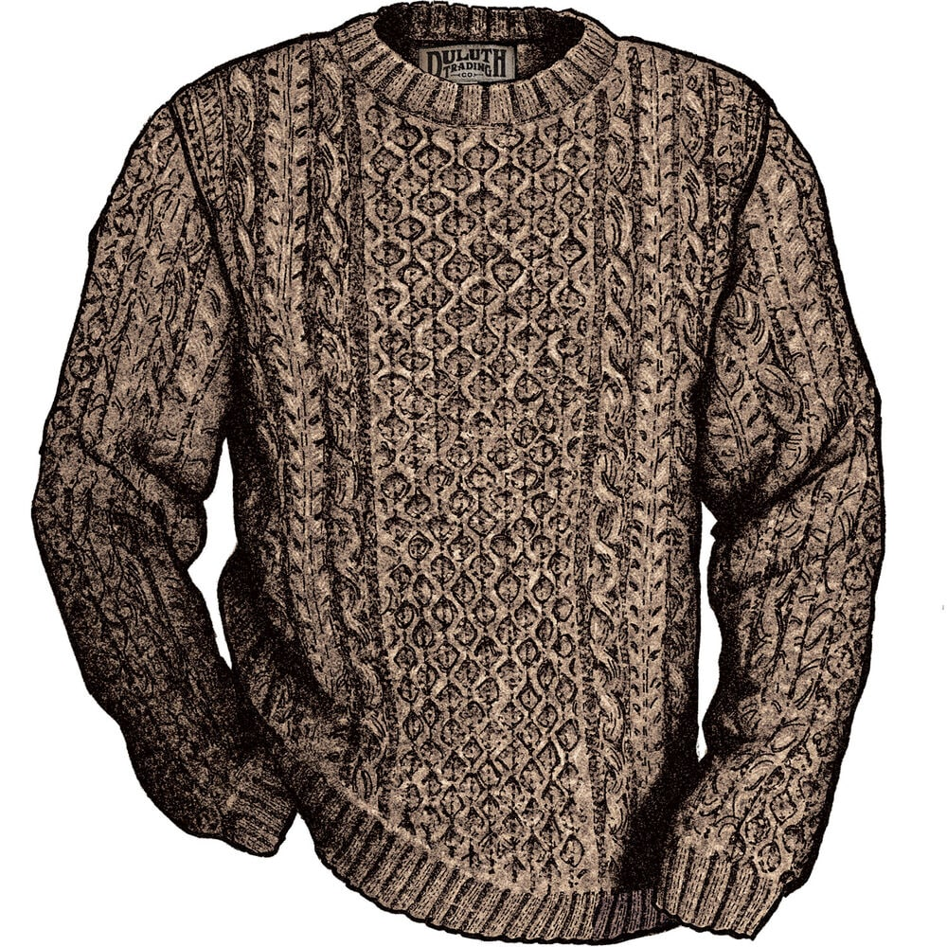
sweater (n)
áo len
/ˈswetə(r)/
She has knitted me beautiful sweaters and socks.

Slide 13
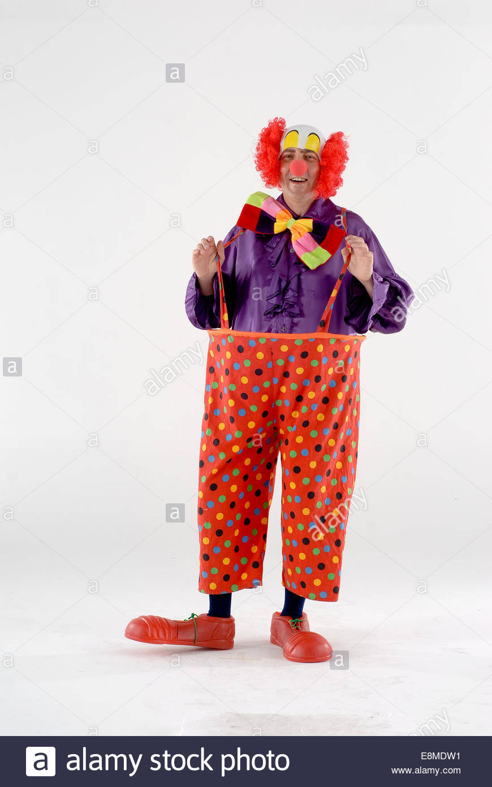
baggy (adj)
rộng thùng thình
/ˈbæɡi/
baggy trousers

Slide 14
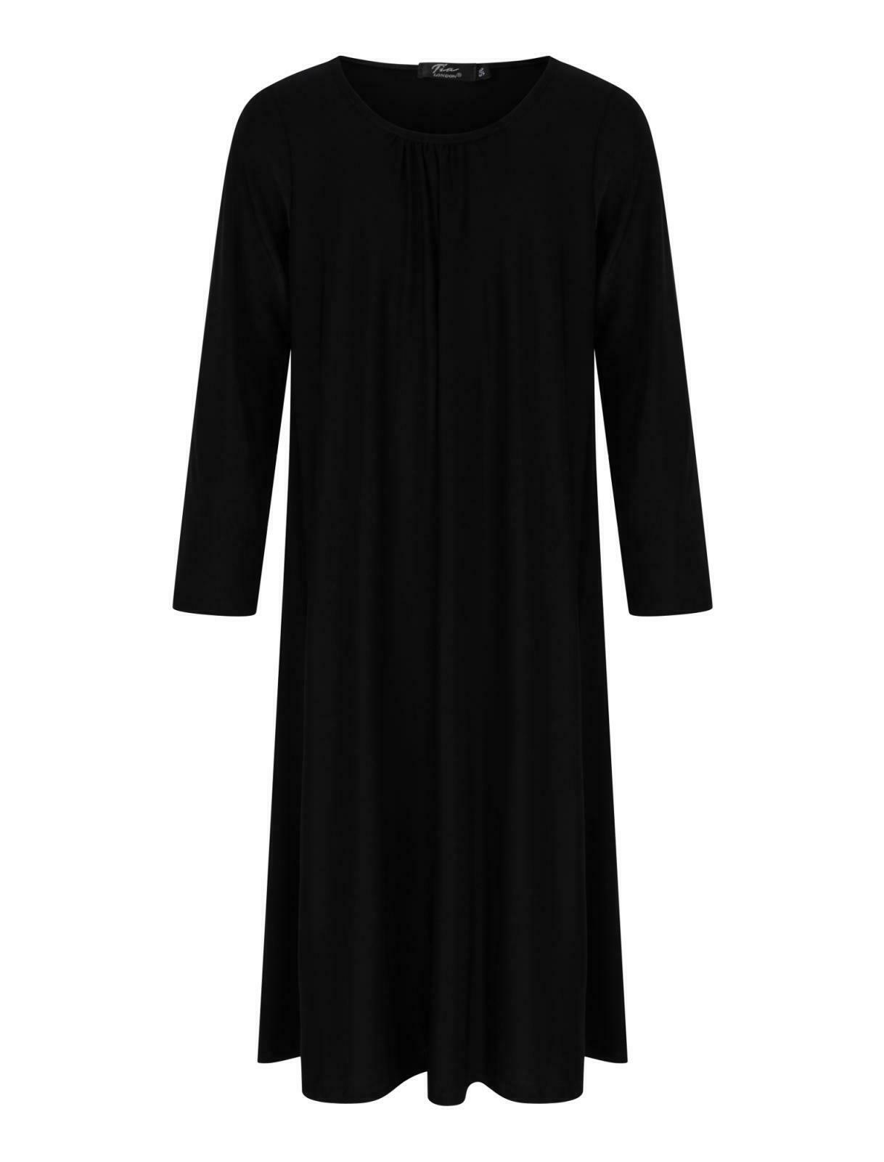
plain (adj)
trơn
/pleɪn/
She wore a plain black dress.

Slide 15
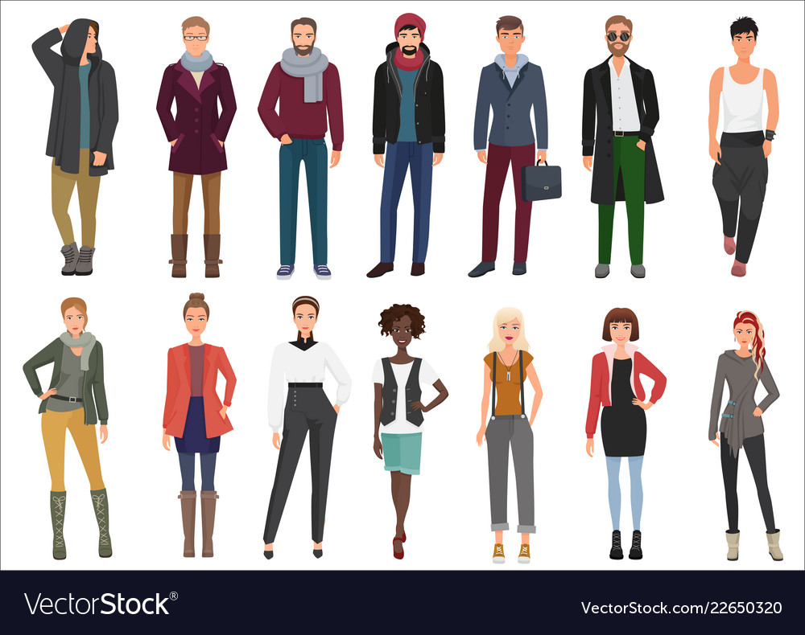
casual clothes
quần áo thông thường
/ˈkæʒuəl kləʊðz/
Everyone else was in jeans and casual gear and I had my office clothes on - I stuck out like a sore thumb.

Slide 16
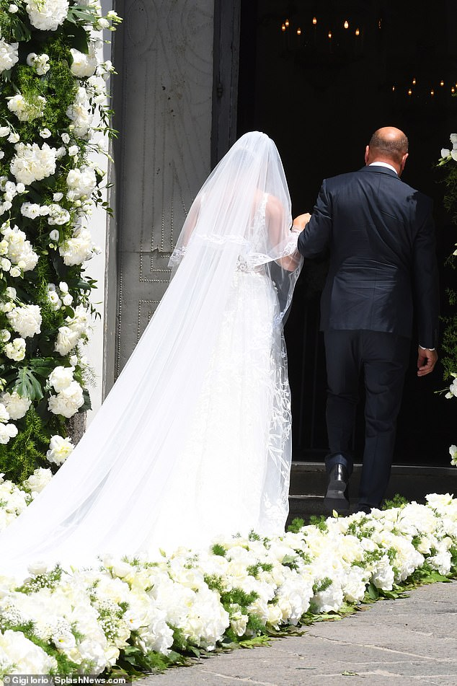
occasion (n)
thời điểm một sự việc xảy ra, dịp
/əˈkeɪ.ʒən/
He visited England on the occasion of his daughter’s wedding.

Slide 17
occasion /əˈkeɪ.ʒən/ (n) : thời điểm một sự việc xảy ra, dịp
+ occasional /əˈkeɪ.ʒənəl/ (adj) : dành cho một dịp đặc biệt + on the occasion of st (phr) : vào thời điểm sự kiện nào đó

Slide 18
stripe
sleeve
plaid
fade
sweater
baggy
plain
casual clothes
occasion

Slide 19
1.stripe /straɪp/ (n) : sọc
+ striped (adj) : có sọc
2. - sleeve /sliːv/ (n) : tay áo
+ sleeved /sliːvd/ (adj) : có tay áo
+ sleeveless /ˈsliːvləs/ (adj) : không có tay
+ short-sleeved (adj) : tay ngắn
3. plaid /plæd/ (adj) : có ca-rô, kẻ ô vuông
4. fade /feɪd/ (v) : làm nhạt
+ fade away : mất dần
+ faded /ˈfeɪ.dɪd/ (adj) : phai màu
5: sweater /ˈswetən(r)/ (n) : áo len
6: baggy /ˈbæɡi/ (adj) : rộng thùng thình
7: plain /pleɪn/ (adj) : trơn
8. casual clothes /ˈkæʒuəl kləʊðz/ (n) : quần áo thông thường
9. occasion /əˈkeɪ.ʒən/ (n) : thời điểm một sự việc xảy ra, dịp
+ occasional /əˈkeɪ.ʒənəl/ (adj) : dành cho một dịp đặc biệt
+ on the occasion of st (phr) : vào thời điểm sự kiện nào đó

Slide 20
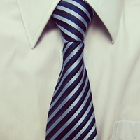
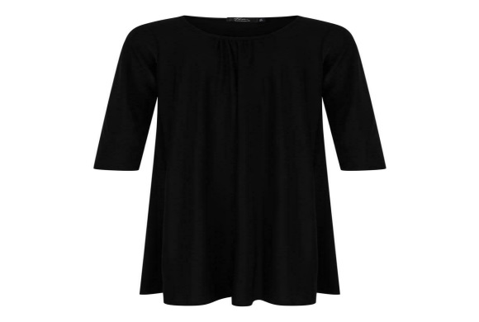
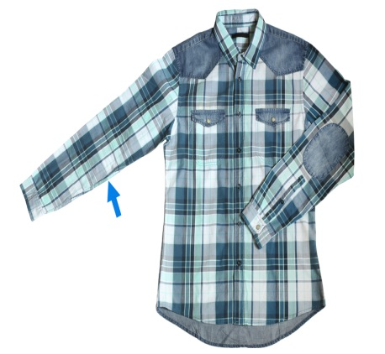
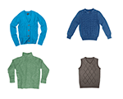

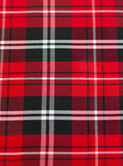

1
4
7
stripe
fade
plain
2
5
8
sweater
casual clothes
sleeve
9
3
6
plaid
baggy
occasion

Slide 21
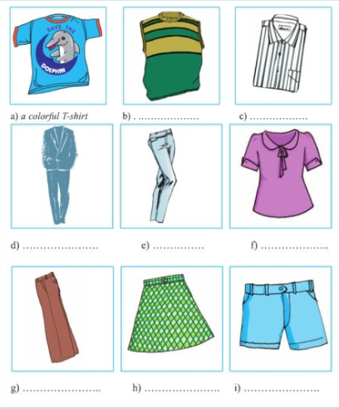
1. Match the phrases to the pictures.
II. PRACTICE
1. a colorful T-shirt
2. a plaid skirt
3. a plain suit
4. a short-sleeved blouse
5. a sleeveless sweater
6. a striped shirt
7. baggy pants
8. faded jeans
9. blue shorts

Slide 22
Answers:
a - 1. a colorful T-shirt
b - 5. a sleeveless sweater
c - 6. a striped shirt
d - 3. a plain suit
e - 8. faded jeans
f - 4. a short - sleeved blouse
g - 7. baggy pants
h - 2. a plaid skirt
i - 9. blue shorts

Slide 23
2. Complete the conservation with given words in the box:
A/ casual clothes B/. What’s your favorite type of clothing?
C/. It’s simple and beautiful D/.Why do you wear these clothes?
E/. I don’t like colorful clothes F/.It makes students to be more polite at school.
-Erik: What do you usually wear on the weekend?
-Son Tung MTP(STMTP): I usually wear (1)_______________, for example a T-shirt and shorts or pants.
-Erik: (2)________________________?
-ST MTP: It’s convenient for me at home.
-Erik: (3)__________________________?
-ST MTP: I like the simple clothes : white shirts and dark trousers. _(4)________________because they are not suitable for the Vietnamese people, especially for girls and young women.
-Erik: What do you think of your school uniform?
-ST MTP: (5)_________________________________ white shirts and dark pants for boys and white shirt and plain skirts for girls. (6)_______________________
Answer :1A, 2D, 3B, 4E, 5C , 6 F

Slide 24
3. TAKE A SURVEY:
NAME | ST1 | ST2 | ST3 | ST4
What do you usually wear on the weekend? Why?
What’s your favorite type of clothing ? Why?
Do you like school uniform?
What do you think of your school uniform?

Slide 25
III. Homework:
-Learn new words by heart.
-Practice the survey.
-Prepare lesson 3: Listen.

