Slide 1


Slide 2


Slide 3
REARRAGEMENT

Slide 4


STOP THE BUS

Slide 5
ANSWER KEY
A tropical storm
that reaches
120 kilometers per hour
tropical storm
that
hurricane
is called
a hurricane
in North and South America.
Vocabulary revision: Natural disaster
Grammar revision: Relative clauses

Slide 6
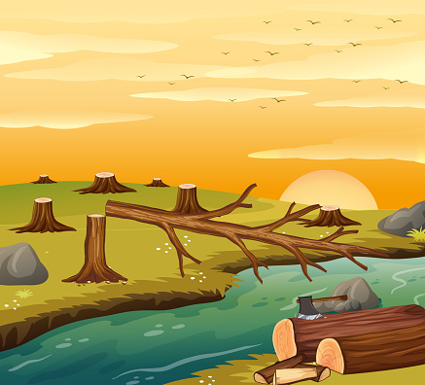

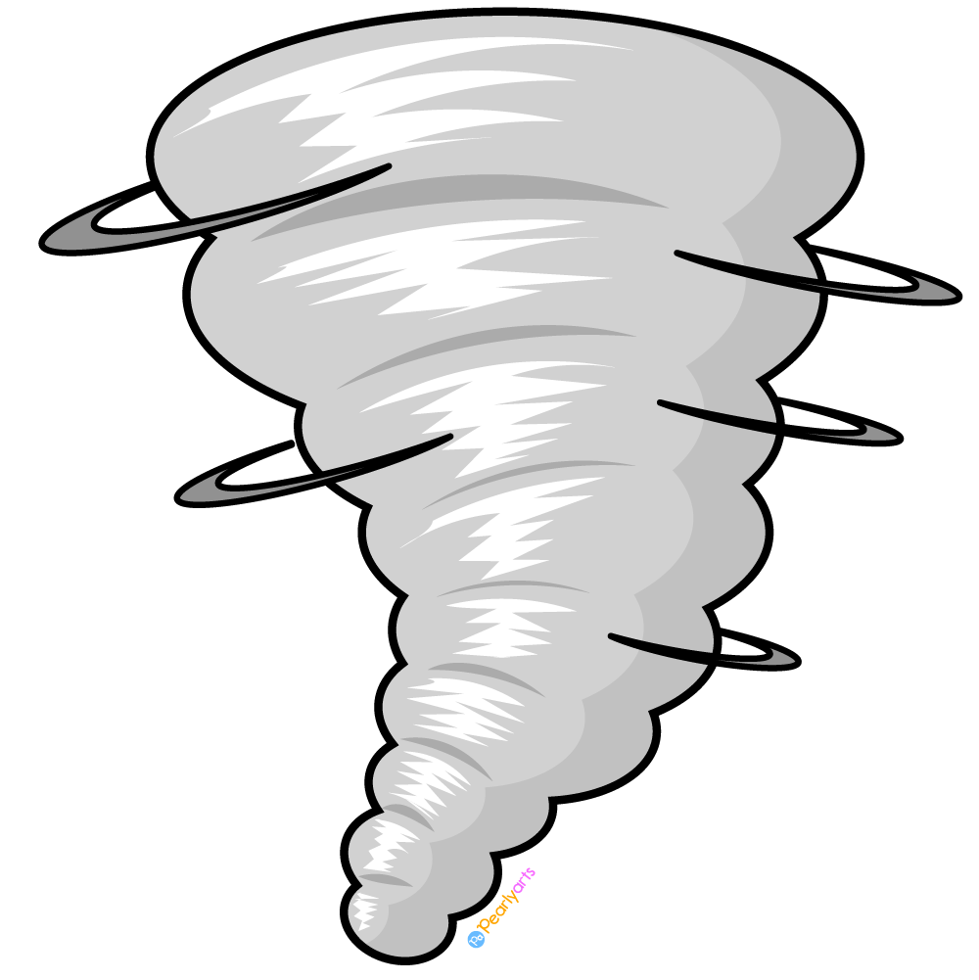
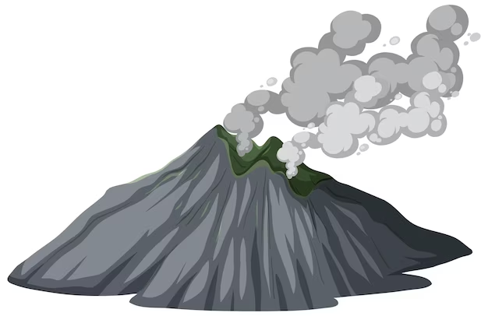
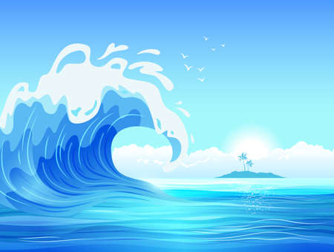
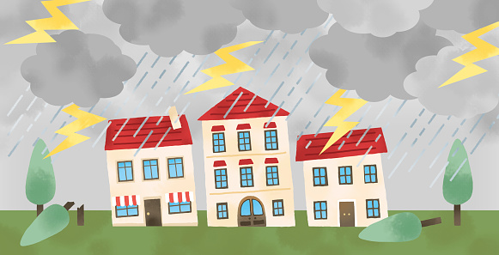
Friday, April 7th , 2023
REVISION

Slide 7
Word form revision
Noun | Verb | Adjective | Adverb
abrupt
destroy
disaster
erupt
expect
predict
science

Slide 8
Word form revision
Noun | Verb | Adjective | Adverb
abruptness
abrupt
abruptly
destruction
destroy
destructive
destructively
disaster
disastrous
disastrously
eruption
erupt
eruptive
expectation
expect
prediction
predict
predictable
predictably
science
scientific
scientist

Slide 9
Word form revision
Noun | Verb | Adjective | Adverb
can
canned
experience
experienced
nature
natural
naturally
sudden
suddenly
tide
tidal
movement
move

Slide 10
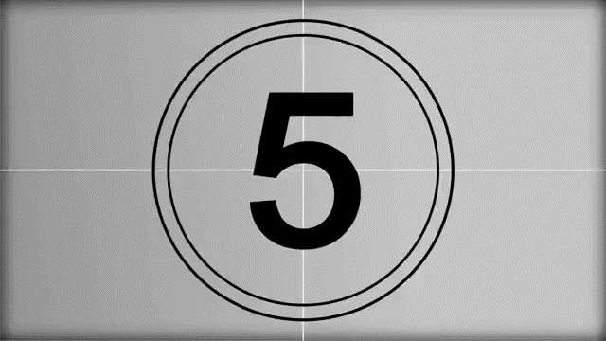
Word form exercises
Question 1:
Contrary to our ___________, he found a well-paid job and a nice girlfriend. (expect)

Slide 11
Word form exercises
Question 2:
_______ ash showered down on the town after the eruption . (volcano)

Slide 12
Word form exercises
Question 3:
Many people are very concerned about the
________ of the rainforest. (destroy)

Slide 13
Word form exercises
Question 4:
The talks ended __________ when one of the delegations walked out in protest. (abrupt)

Slide 14
Word form exercises
Question 5:
Earthquakes often come together with volcanic ____________. (erupt)

Slide 15
Word form exercises
Question 6: Our country is near the equator. It is a __________ country. (tropics)

Slide 16
Word form exercises
Question 7: The weather is so __________ that I don’t know if I should take an umbrella or suntan lotion. (predict)

Slide 17
Word form exercises
Question 8: He made a sudden __________ and frightened the bird away. (move)

Slide 18
Word form exercises
Question 1:
Contrary to our ___________, he found a well-paid job and a nice girlfriend. (expect)
expectations

Slide 19
Word form exercises
Question 2:
_______ ash showered down on the town after the eruption . (volcano)
Volcanic

Slide 20
Word form exercises
Question 3:
Many people are very concerned about the
________ of the rainforest. (destroy)
destruction

Slide 21
Word form exercises
Question 4:
The talks ended __________ when one of the delegations walked out in protest. (abrupt)
abruptly

Slide 22
Word form exercises
Question 5:
Earthquakes often come together with volcanic ____________. (erupt)
eruptions

Slide 23
Word form exercises
Question 6: Our country is near the equator. It is a __________ country. (tropics)
tropical

Slide 24
Word form exercises
unpredictable
Question 7: The weather is so __________ that I don’t know if I should take an umbrella or suntan lotion. (predict)

Slide 25
Word form exercises
movement
Question 8: He made a sudden __________ and frightened the bird away. (move)

Slide 26
Grammar revision

Slide 27


RELATIVE CLAUSES
1. Nouns (people) + who + S + V ….
2. Nouns (people) + who + V ….
3. Nouns (people) + whom + S + V ….

Slide 28

RELATIVE CLAUSES
1. Nouns (things) + which + S + V ….
2. Nouns (things) + which + V ….

Slide 29

RELATIVE CLAUSES
1. Nouns + whose + N …..

Slide 30

RELATIVE CLAUSES
who/ whom/ which = that
* “that” is not used in the Non-defining
relative clauses

Slide 31
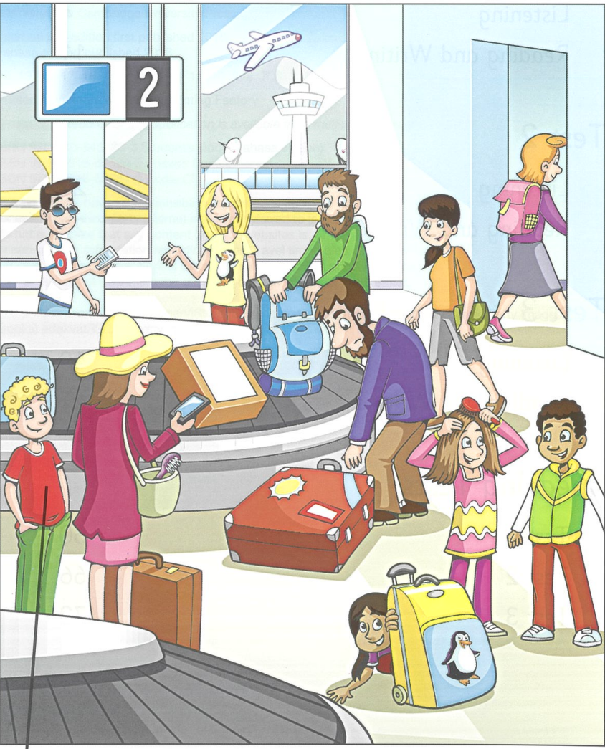
Betty
Helen
William
Michael
Holly
David
May
Robert
Mary

Slide 32
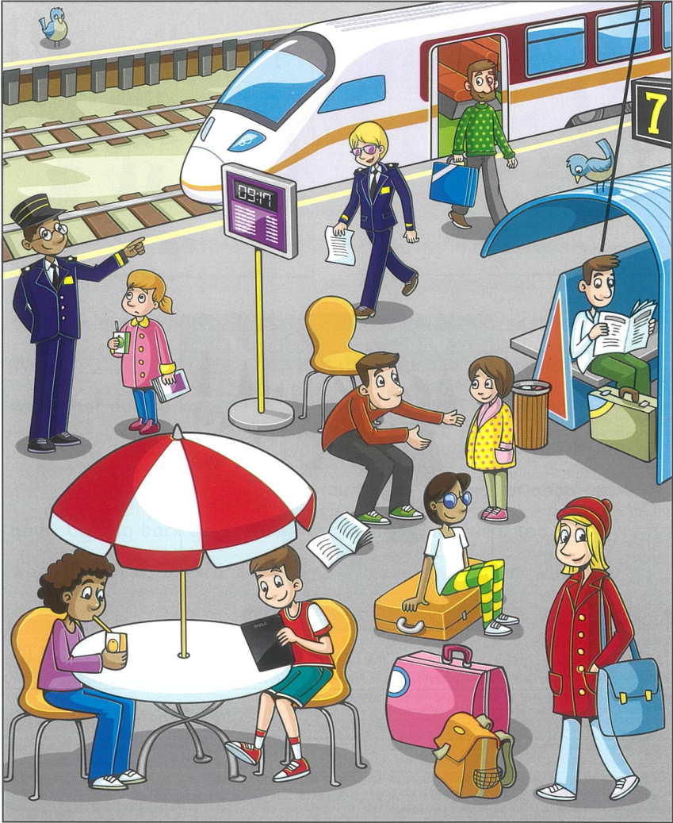
Tony
William
David
May
Michael
Robert
Holly
Helen
Mary

Slide 33
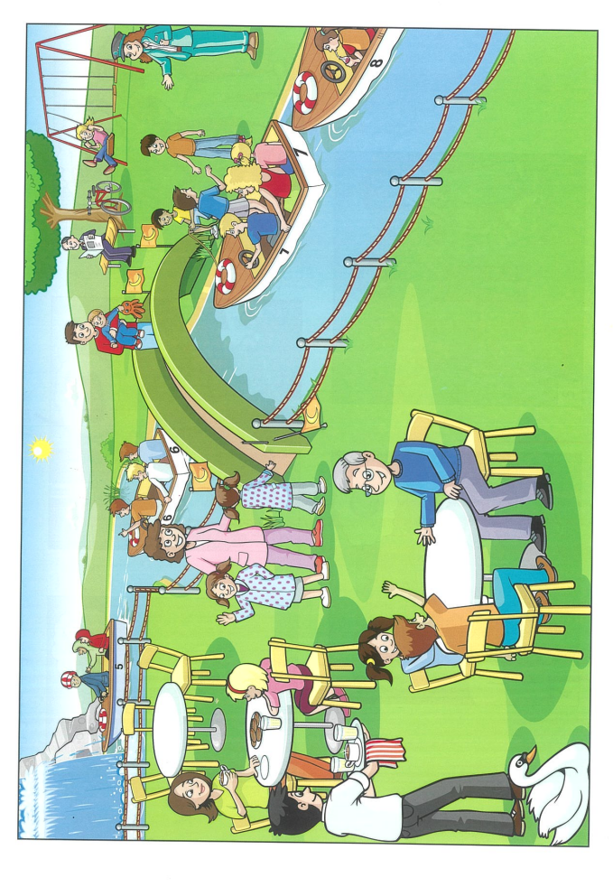
The man who is wearing glasses is sitting on a chair.

Slide 34
HOMEWORK
Learn by heart the word family of unit 9.
Learn by heart the structures of Relative clauses
Prepare for Unit 10. Getting started – Listen and Read on page 83.

Slide 35


