Slide 1

Welcome

Slide 2
Warm
up!

Slide 3

Timeline Game
01
15 seconds to look at the information
Remember the names and the years
Arrange the inventions from the past up to the present
02
03

Slide 4

Inventions
Televisions: Electronic television was first successfully demonstrated in San Francisco on Sept. 7, 1927
Printed newspapers: The first printed newspapers were published weekly in Germany from 1609.
Radio: In 1895, a young Italian named Gugliemo Marconi invented what he called “the wireless telegraph” while experimenting in his parents’ attic. He used radio waves to transmit Morse code and the instrument he used became known as the radio.

Slide 5
Inventions
Magazines: German theologian and poet Johann Rist published the first true magazine between 1663 and 1668.
The Internet: The Internet was developed by Bob Kahn and Vint Cerf in the 1970s
Telephone: Since coming to America as a teacher of the deaf, Alexander Graham Bell had thought a way to transmit speech electronically. He invented the telephone in March 1876.

Slide 6


Suggested answers
1. Printed newspapers (1609)
2. Magazines (between 1663 and 1668)
3. Telephones (1876)
4. Radio (1895)
5. Televisions (1927)
6. The Internet (1970s)

Slide 7

THE
MEDIA

Slide 8
Friday, November 18th , 2022
“
UNIT 5. THE MEDIA
GETTING STARTED LISTEN AND READ

Slide 9
New
words

Slide 10
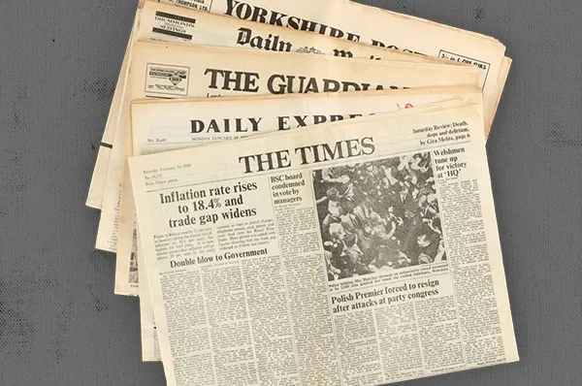

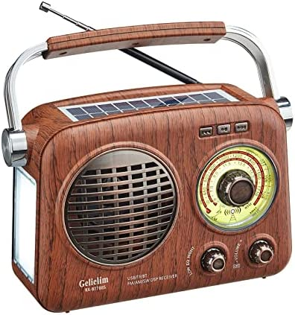

the media (n)
/ˈmiː.di.ə/

Slide 11
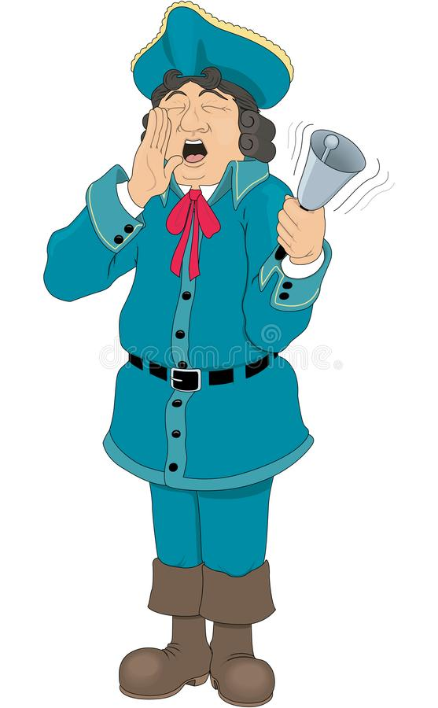
town crier (n)
/ˌtaʊn ˈkraɪ.ər/
ringing a bell
shouting the latest news

Slide 12

develop (v)
/dɪˈvel.əp/
👉🏻 development (n)

Slide 13
a variety of (v)
/vəˈraɪ.ə.ti/
 many, a lot of

Slide 14
interact (v) /ˌɪn.təˈrækt/
interactive (adj)
interaction (n)
 to communicate with or react to

Slide 15

remote control (n)
/rɪˌməʊt kənˈtrəʊl/

Slide 16
NEW WORDS
the media (n) /ˈmiː.di.ə/: phương tiện truyền thông đại chúng
town crier /ˌtaʊn ˈkraɪ.ər/ : người đưa tin
develop (v) /dɪˈvel.əp/: phát triển
development (n): sự phát triển
a variety of /vəˈraɪ.ə.ti/: nhiều
interact (v) /ˌɪn.təˈrækt/: tương tác
interaction (n): sự tương tác
interactive (adj): có tính tương tác
remote control /rɪˌməʊt kənˈtrəʊl/: điều khiển từ xa

Slide 17
Time for Games
01
Guess the words
Stand up and read them out
02

Slide 18

d
e
v
e
l
o
p

Slide 19
m
e
d
i
a

Slide 20
r
e
m
o
t
e
c
o
n
t
r
o
l

Slide 21
t
o
w
n
c
r
i
e
r

Slide 22
i
n
t
e
r
a
c
t

Slide 23
v
a
r
i
e
t
y

Slide 24


Slide 25

THE MEDIA

Slide 26

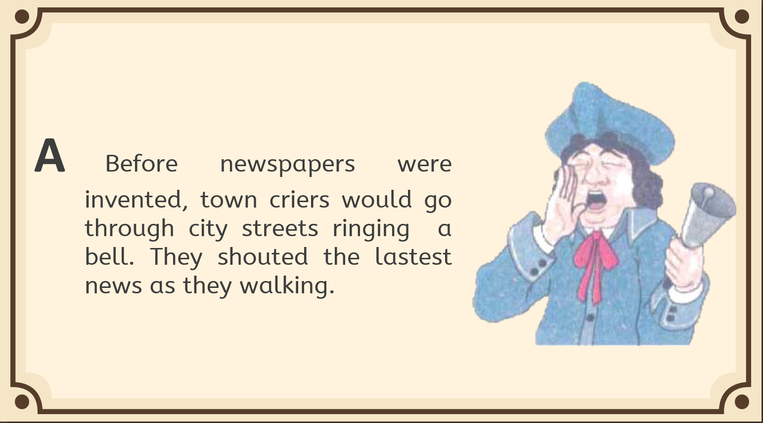
did you know?

Slide 27
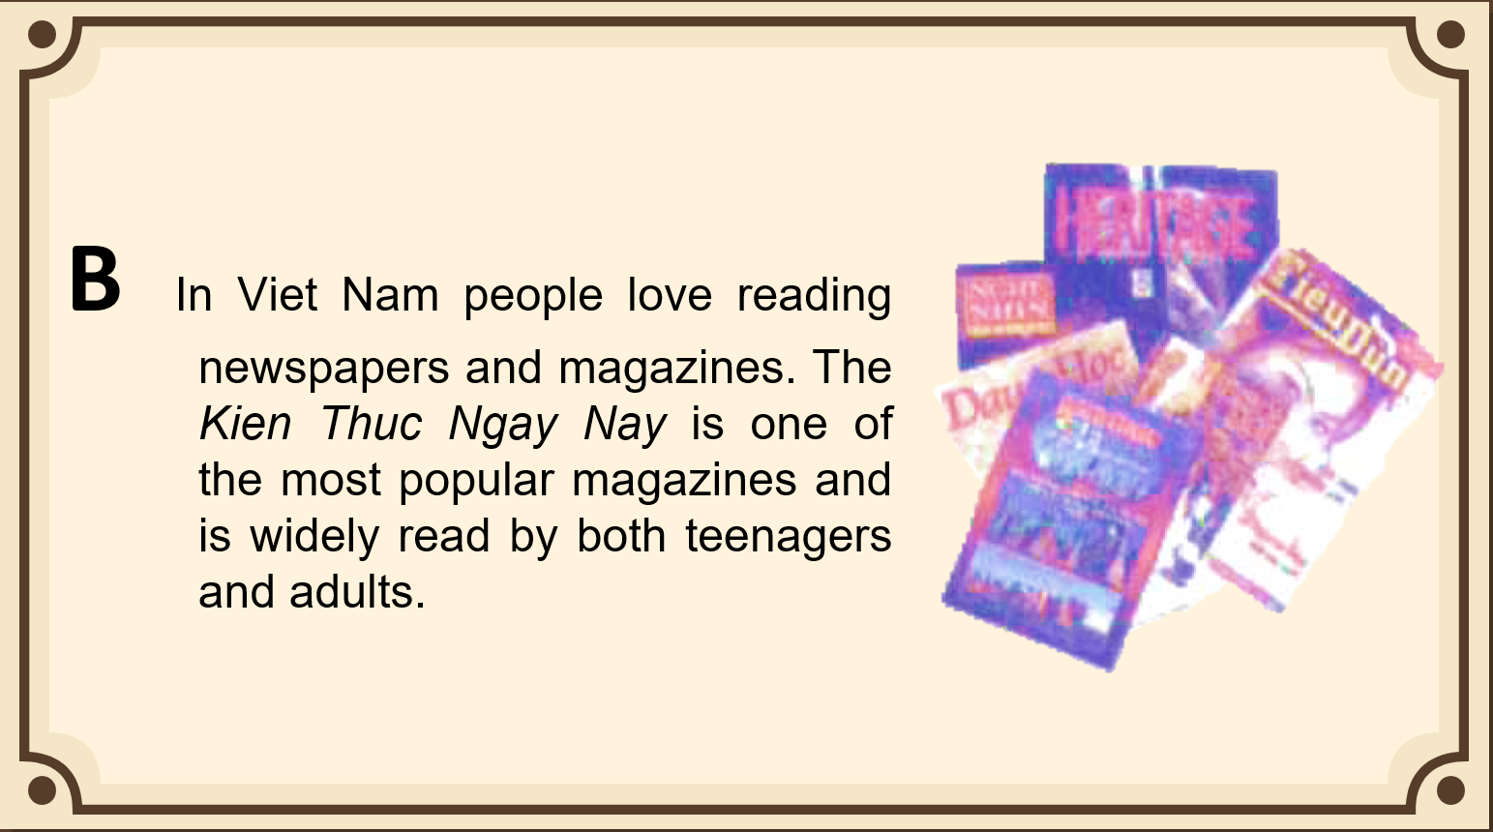
did you know?

Slide 28
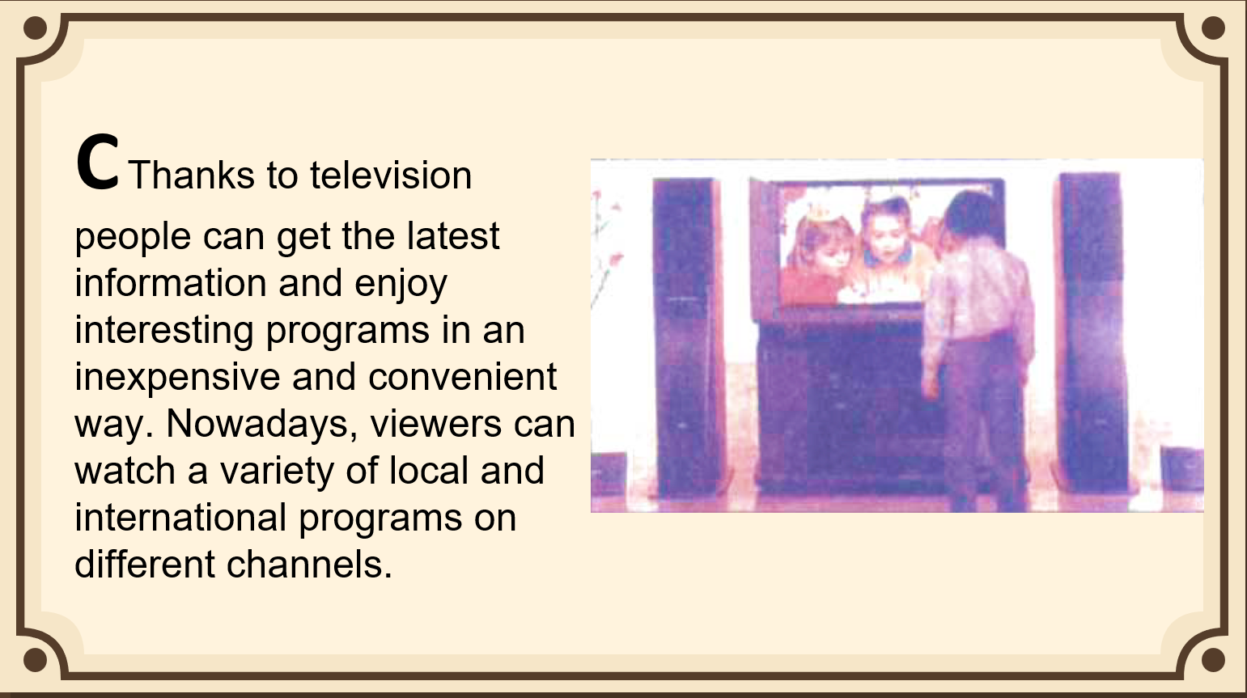
did you know?

Slide 29
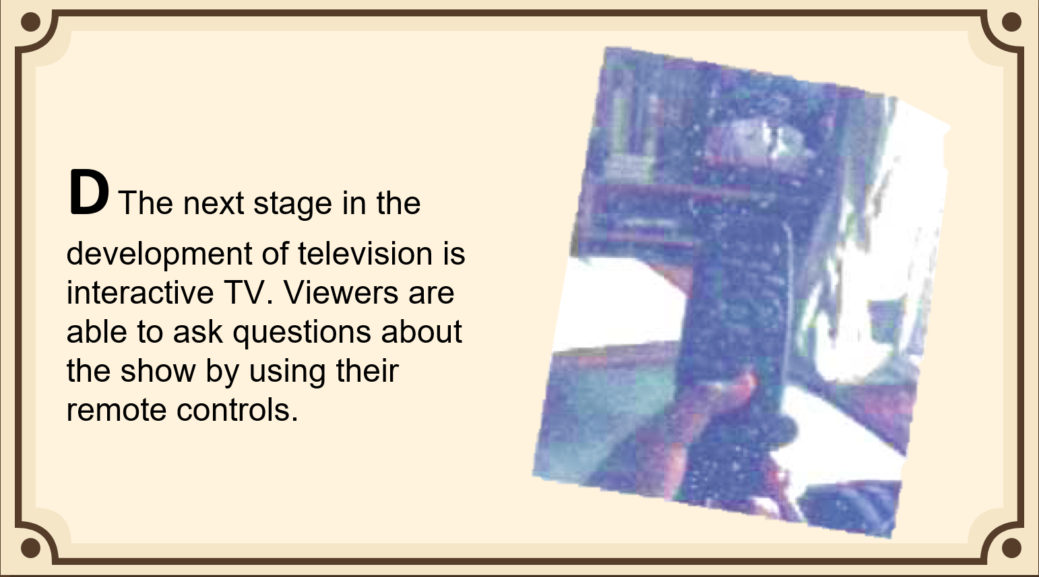
did you know?

Slide 30
a. Complete the table with the passage letters in which these facts or events are mentioned.
Facts & Events | Passage Letter
1. Remote controls are used to interact with TV. | D
2. One of the most popular magazines
3. People of different ages like this magazine.
4. Benefits of TV
5. People got the news from town criers.
6. Interactive TV is available now.
B
B
C
A
D

Slide 31
TRUE or FALSE ?
01
Work in groups
Write TRUE or FALSE
10 seconds for each statement
02
03

Slide 32

TRUE OR FALSE
1. A town crier was a person who went through city streets ringing the radio and shouting the latest news.

Slide 33
TRUE OR FALSE
2. The Kien Thuc Ngay Nay is popular with both teenagers and adults.

Slide 34
TRUE OR FALSE
3. Thanks to television, people can watch many foreign programs on different channels.

Slide 35
TRUE OR FALSE
4. It is expensive to enjoy interesting programs on television.

Slide 36
TRUE OR FALSE
5. Remote controls are used to ask questions about the show on TV.

Slide 37
TRUE OR FALSE
FALSE
1. A town crier was a person who went through city streets ringing the radio and shouting the latest news.

Slide 38
TRUE OR FALSE
TRUE
2. The Kien Thuc Ngay Nay is popular with both teenagers and adults.

Slide 39
TRUE OR FALSE
TRUE
3. Thanks to television, people can watch many foreign programs on different channels.

Slide 40
TRUE OR FALSE
FALSE
4. It is expensive to enjoy interesting programs on television.

Slide 41
TRUE OR FALSE
TRUE
5. Remote controls are used to ask questions about the show on TV.

Slide 42






Social Media

Slide 43
PRESENTATION
What is it used for?
What are some advantages?
Are there any disadvantages?

Slide 44
HOMEWORK
Learn by heart new words
Do exercise b on page 42
Prepare for Unit 5 – READ on page 43

Slide 45
thank you!
Do you have any questions?

